Slide 1
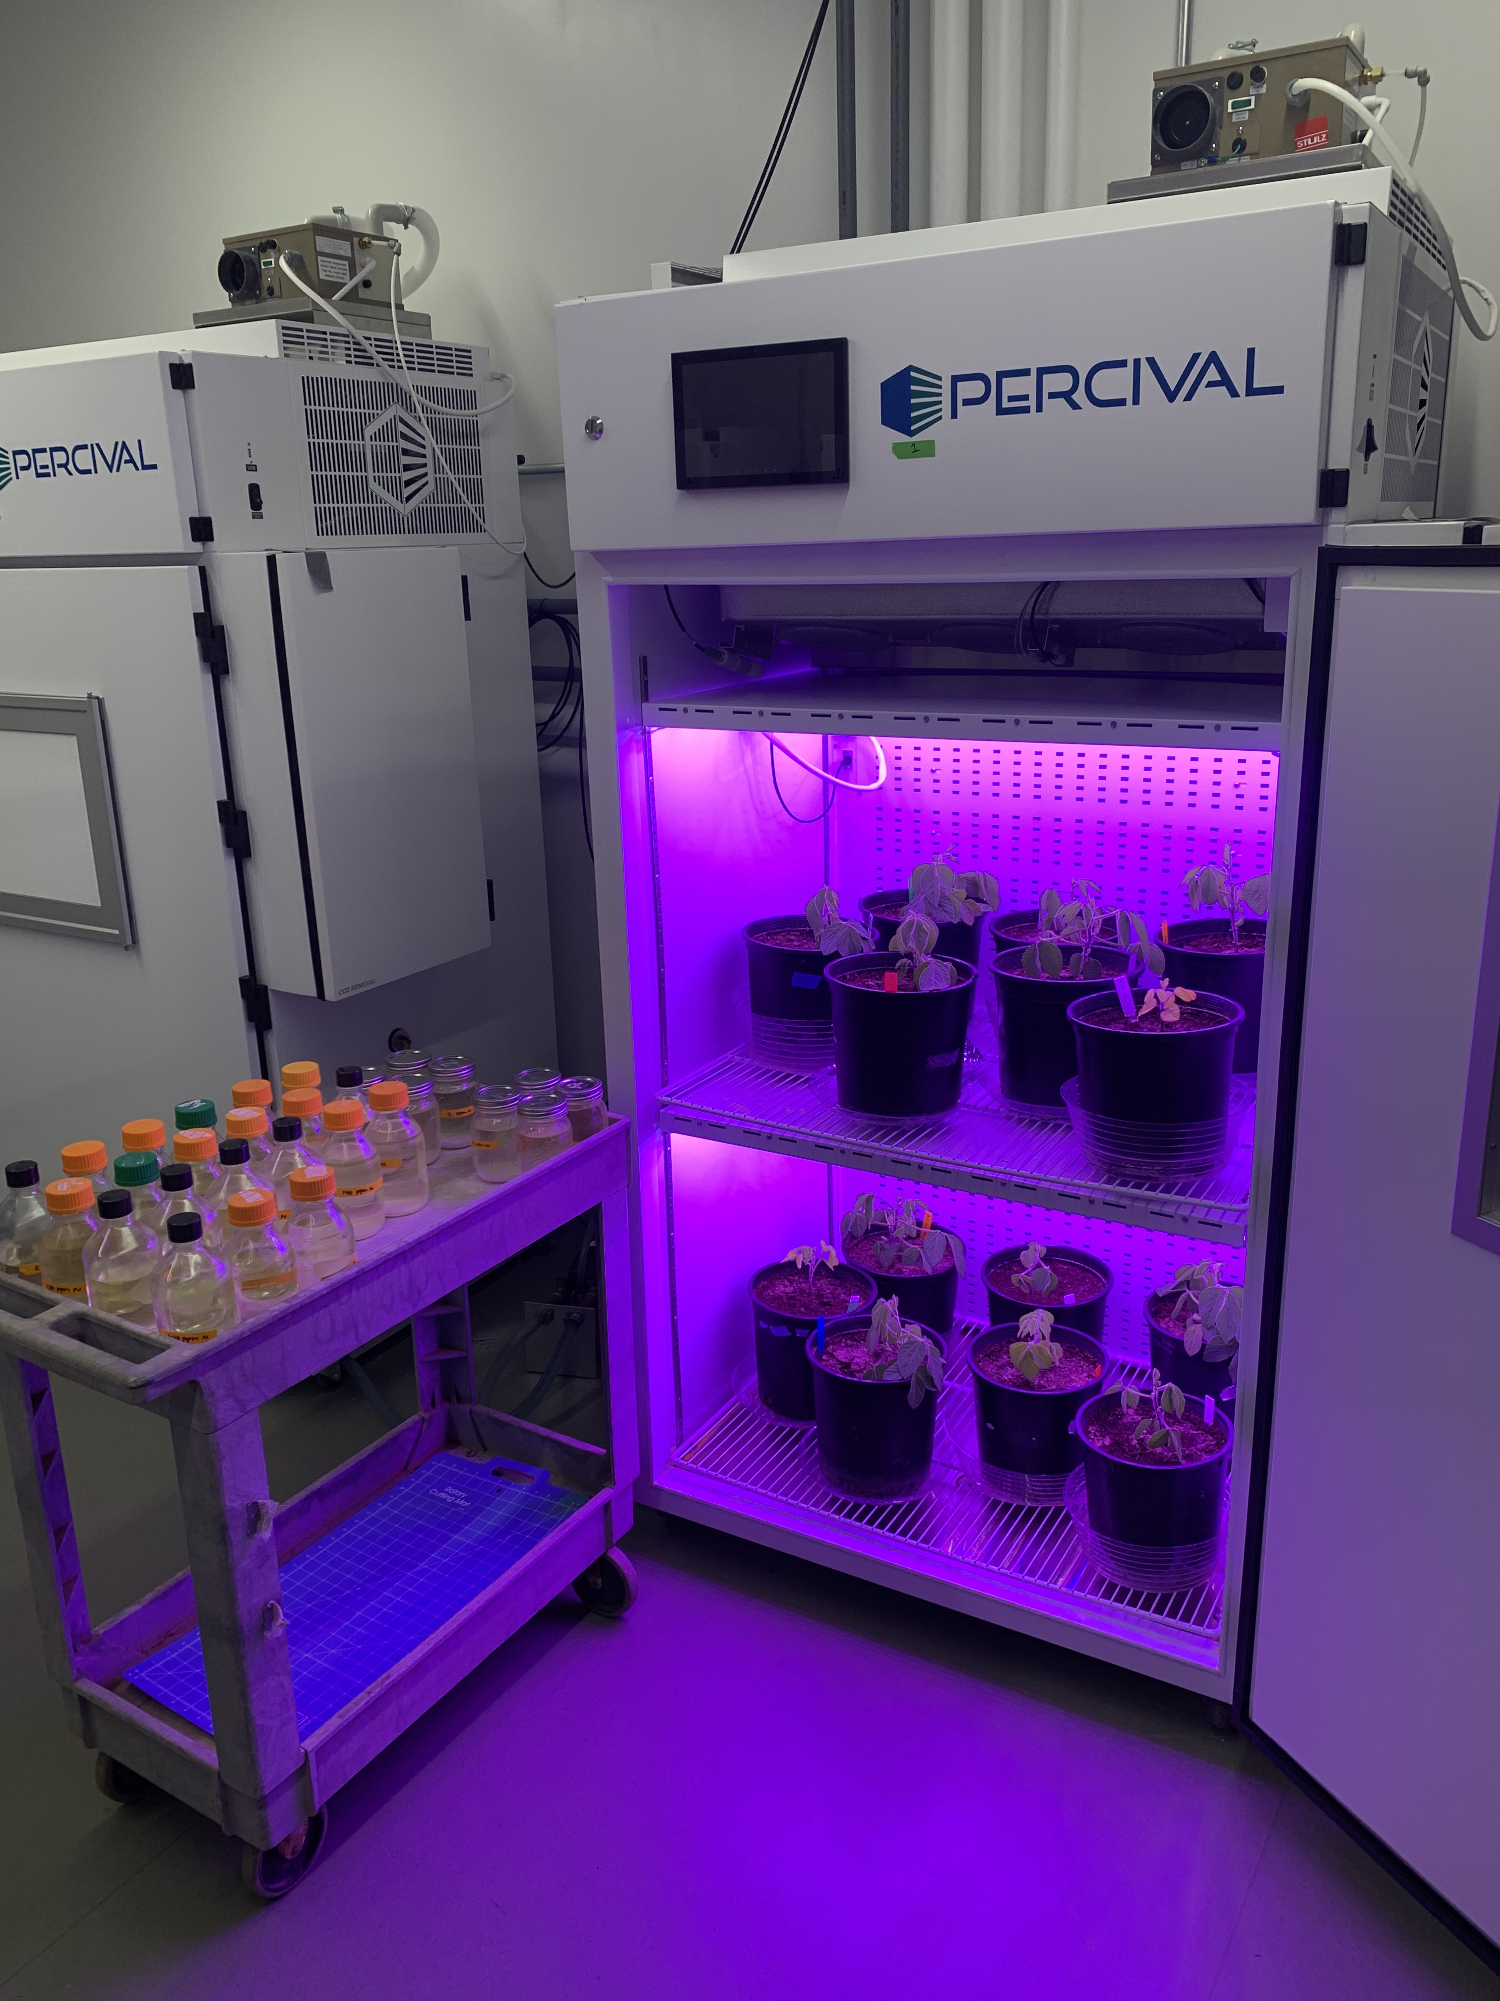





Nitrogen supply and demand control plant responses to elevated CO₂ at difference scales
Ezinwanne
Ezekannagha
Evan Perkowski
Nick Smith

Slide 2
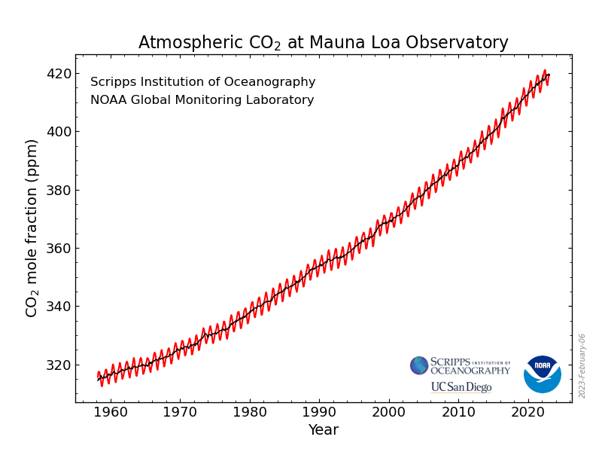
https://gml.noaa.gov/ccgg/trends/

Slide 3
33% increase in CO₂ concentration since 1960
61% of this increase has occurred since 1990
https://gml.noaa.gov/ccgg/trends/

Slide 4
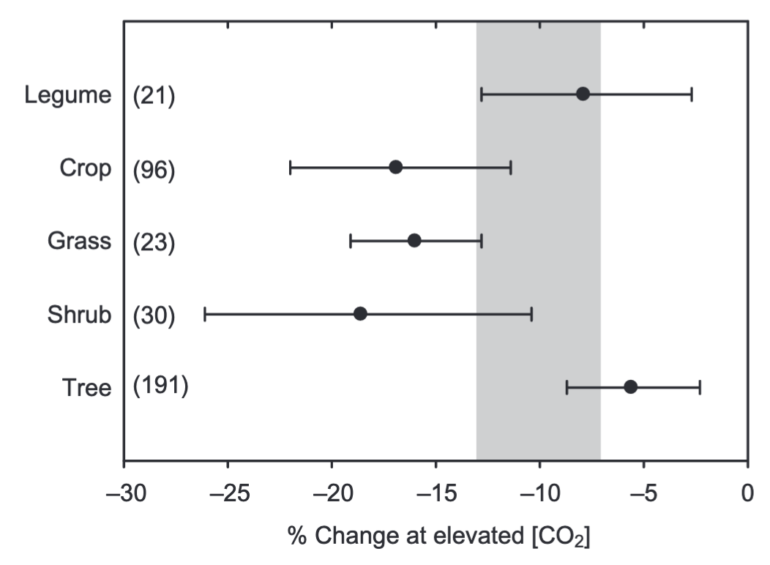
Plants grown under elevated CO₂ exhibit reduced photosynthetic capacity
Photosynthetic capacity
Ainsworth & Rogers (2007) PC&E

Slide 5
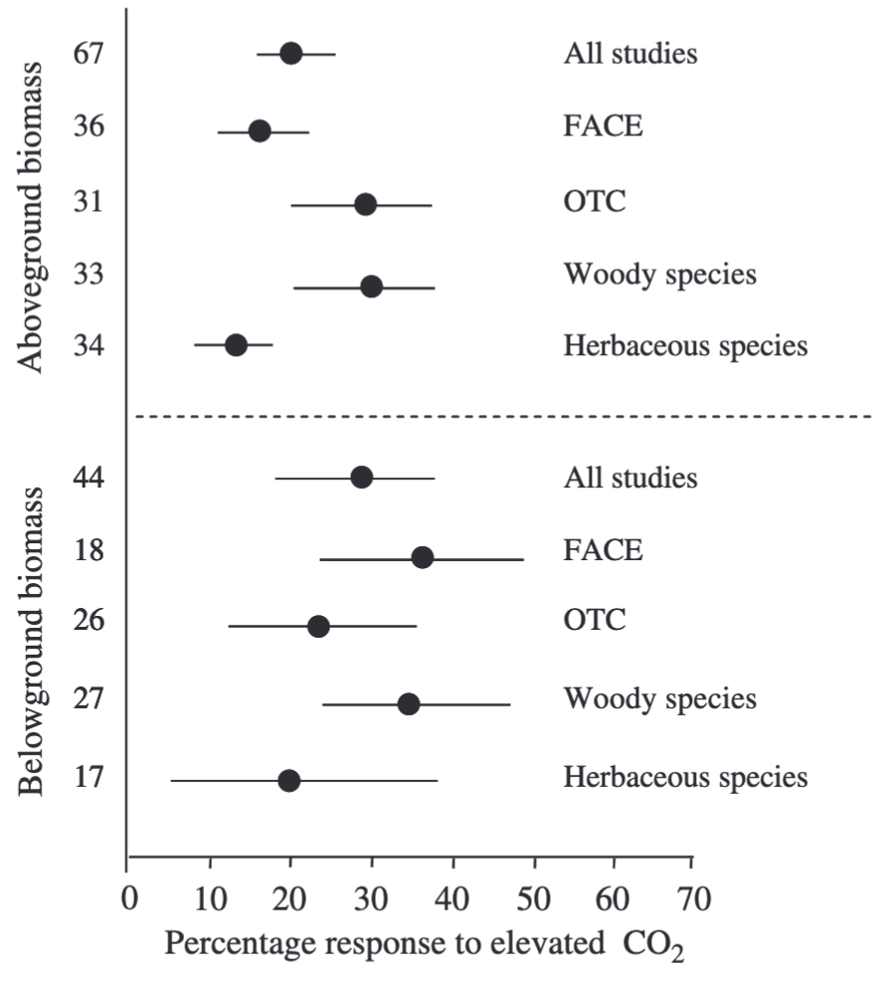
Reduced photosynthetic capacity under elevated CO₂ often corresponds with increased whole-plant growth
Aboveground biomass
Belowground biomass
de Graaf et al. (2006) Global Change Biology

Slide 6
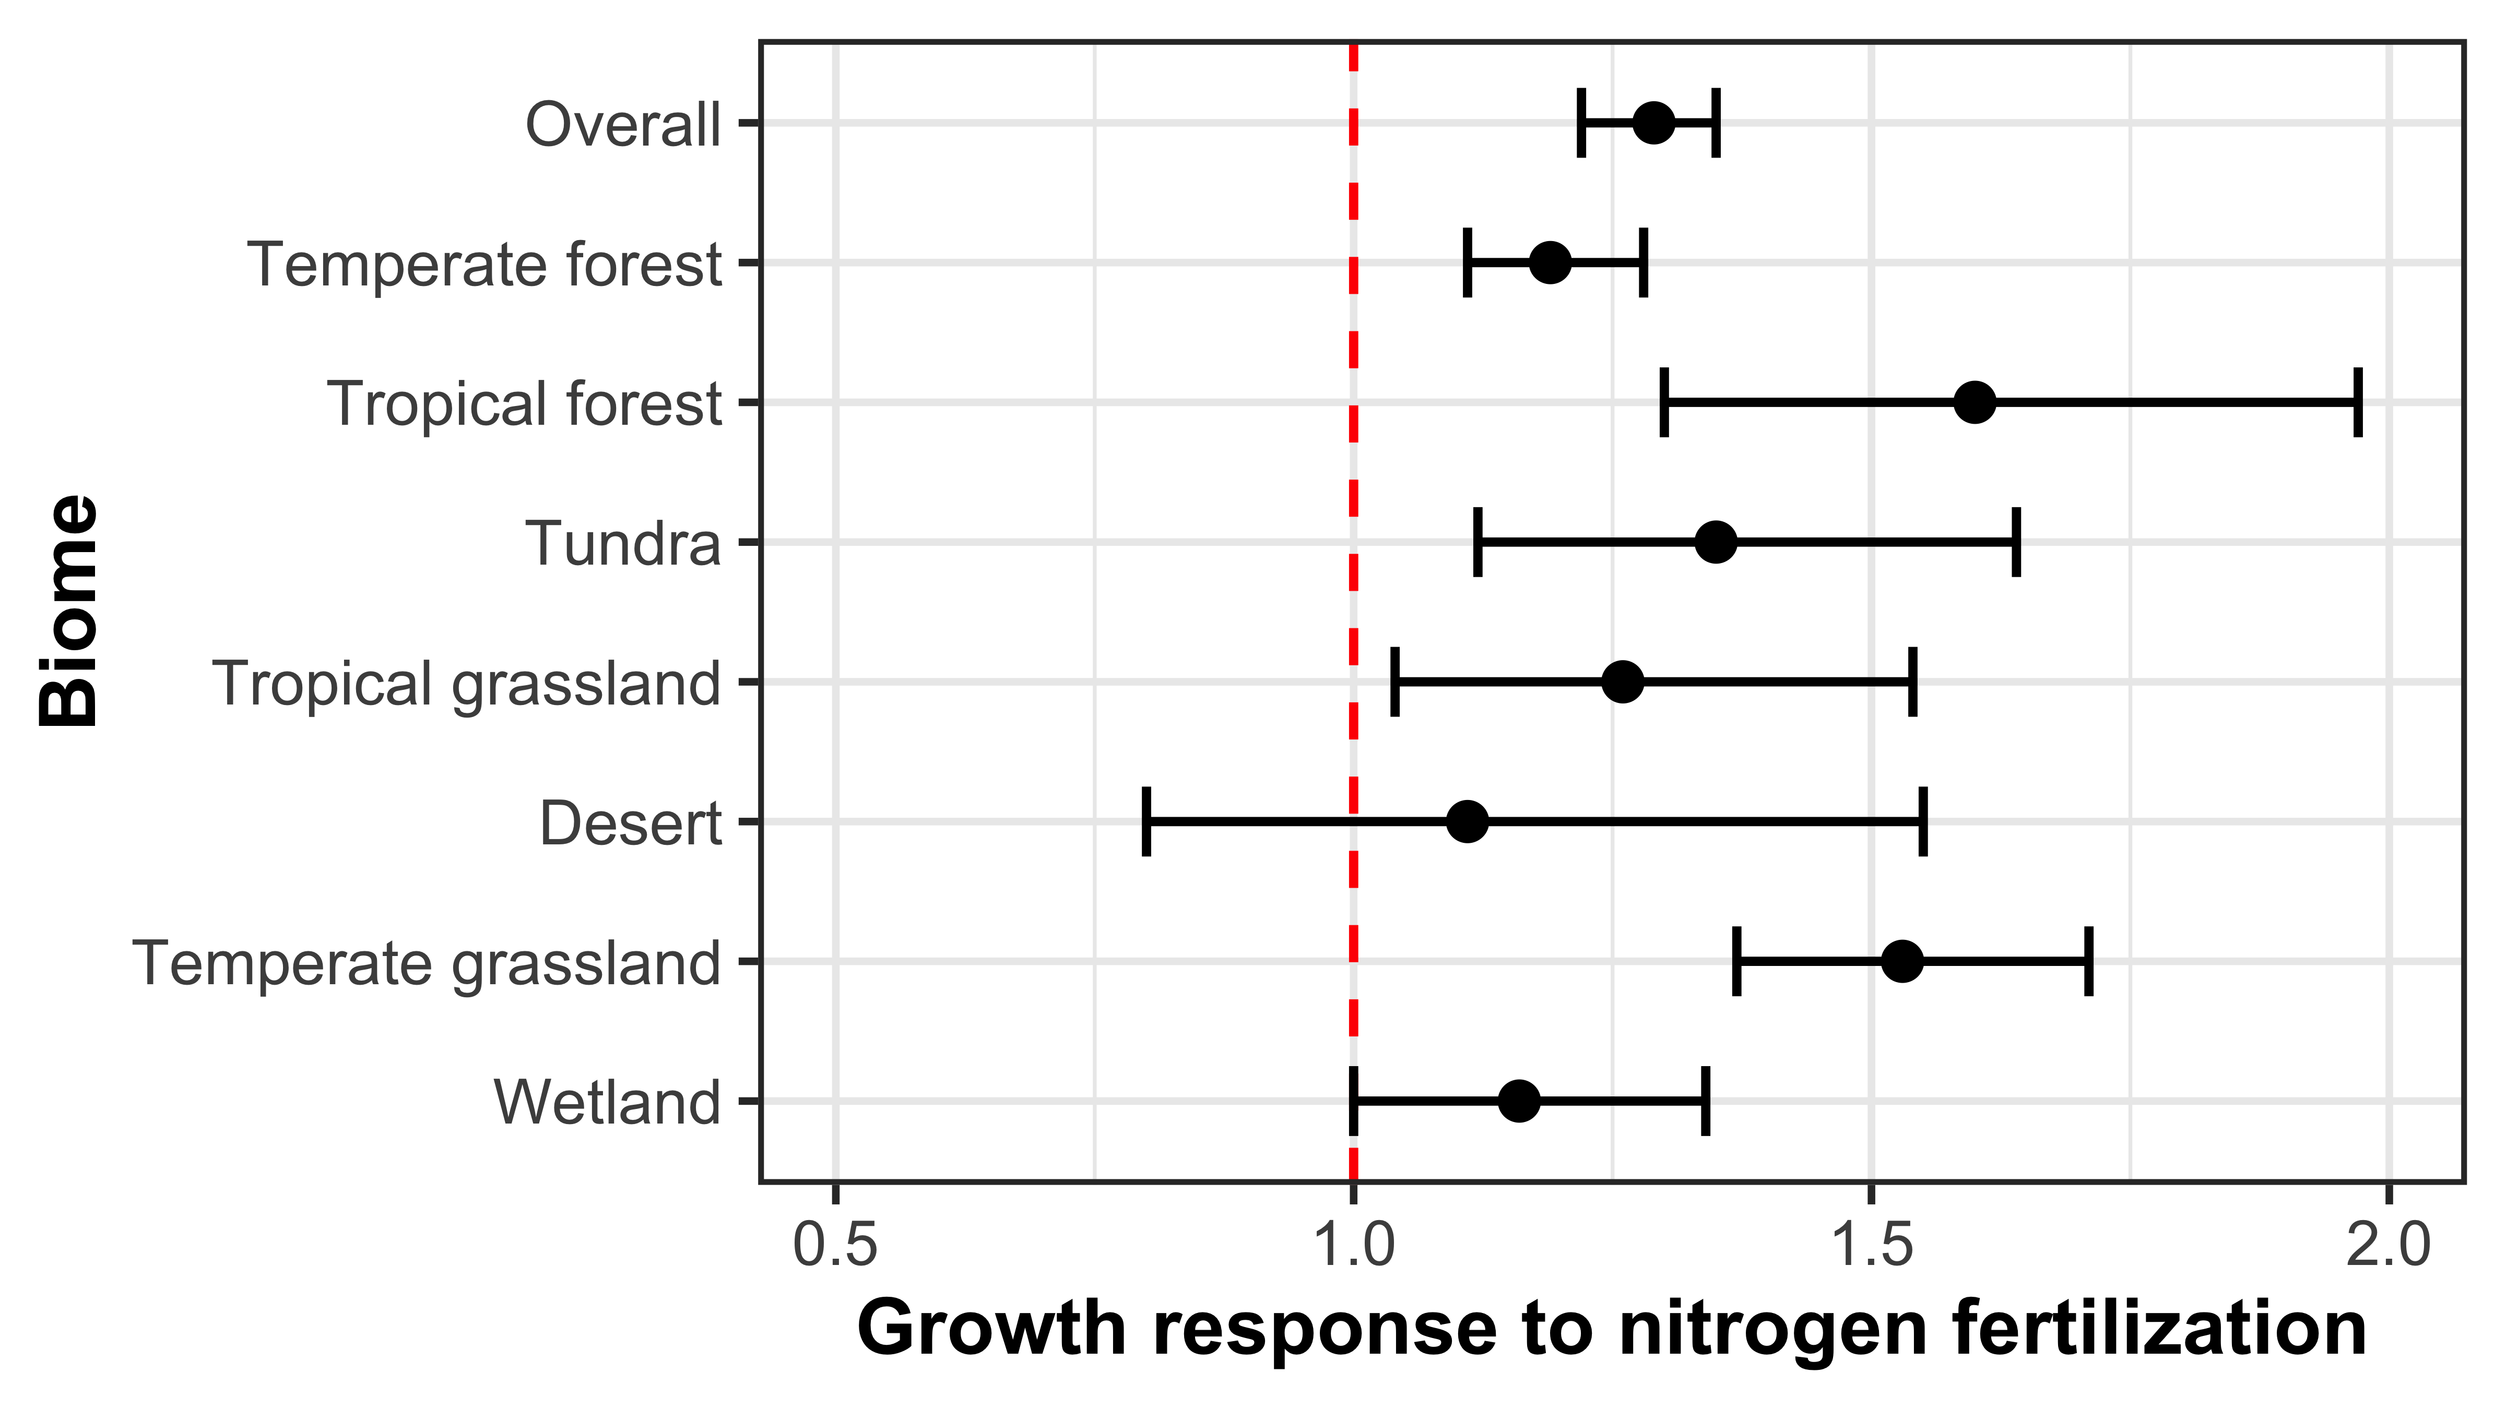
Some have hypothesized that nutrient availability controls plant responses to elevated CO₂
N addition increased
NPP across biomes by 29%
Figure adapted from Table 1 in LeBauer & Treseder (2008) Ecology

Slide 7
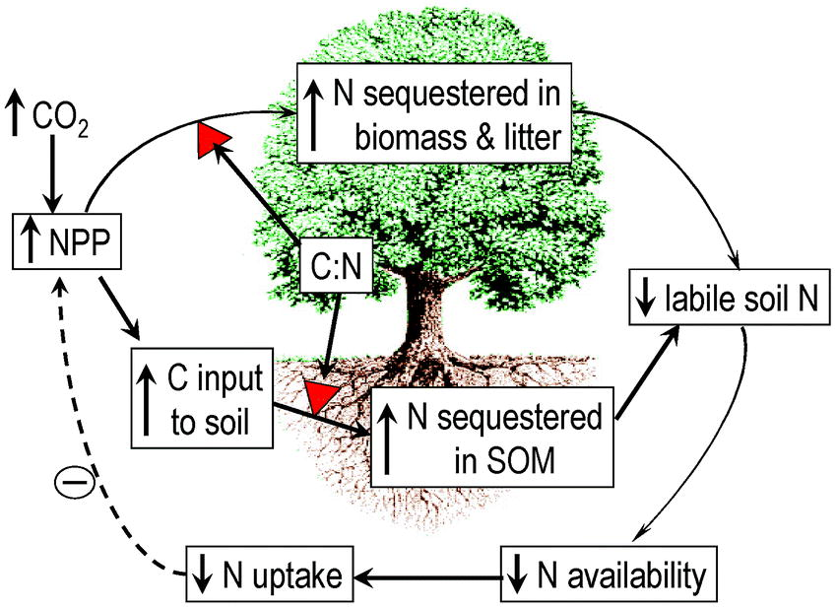
Some have hypothesized that nutrient availability controls plant responses to elevated CO₂
Luo et al. (2004) BioScience

Slide 8
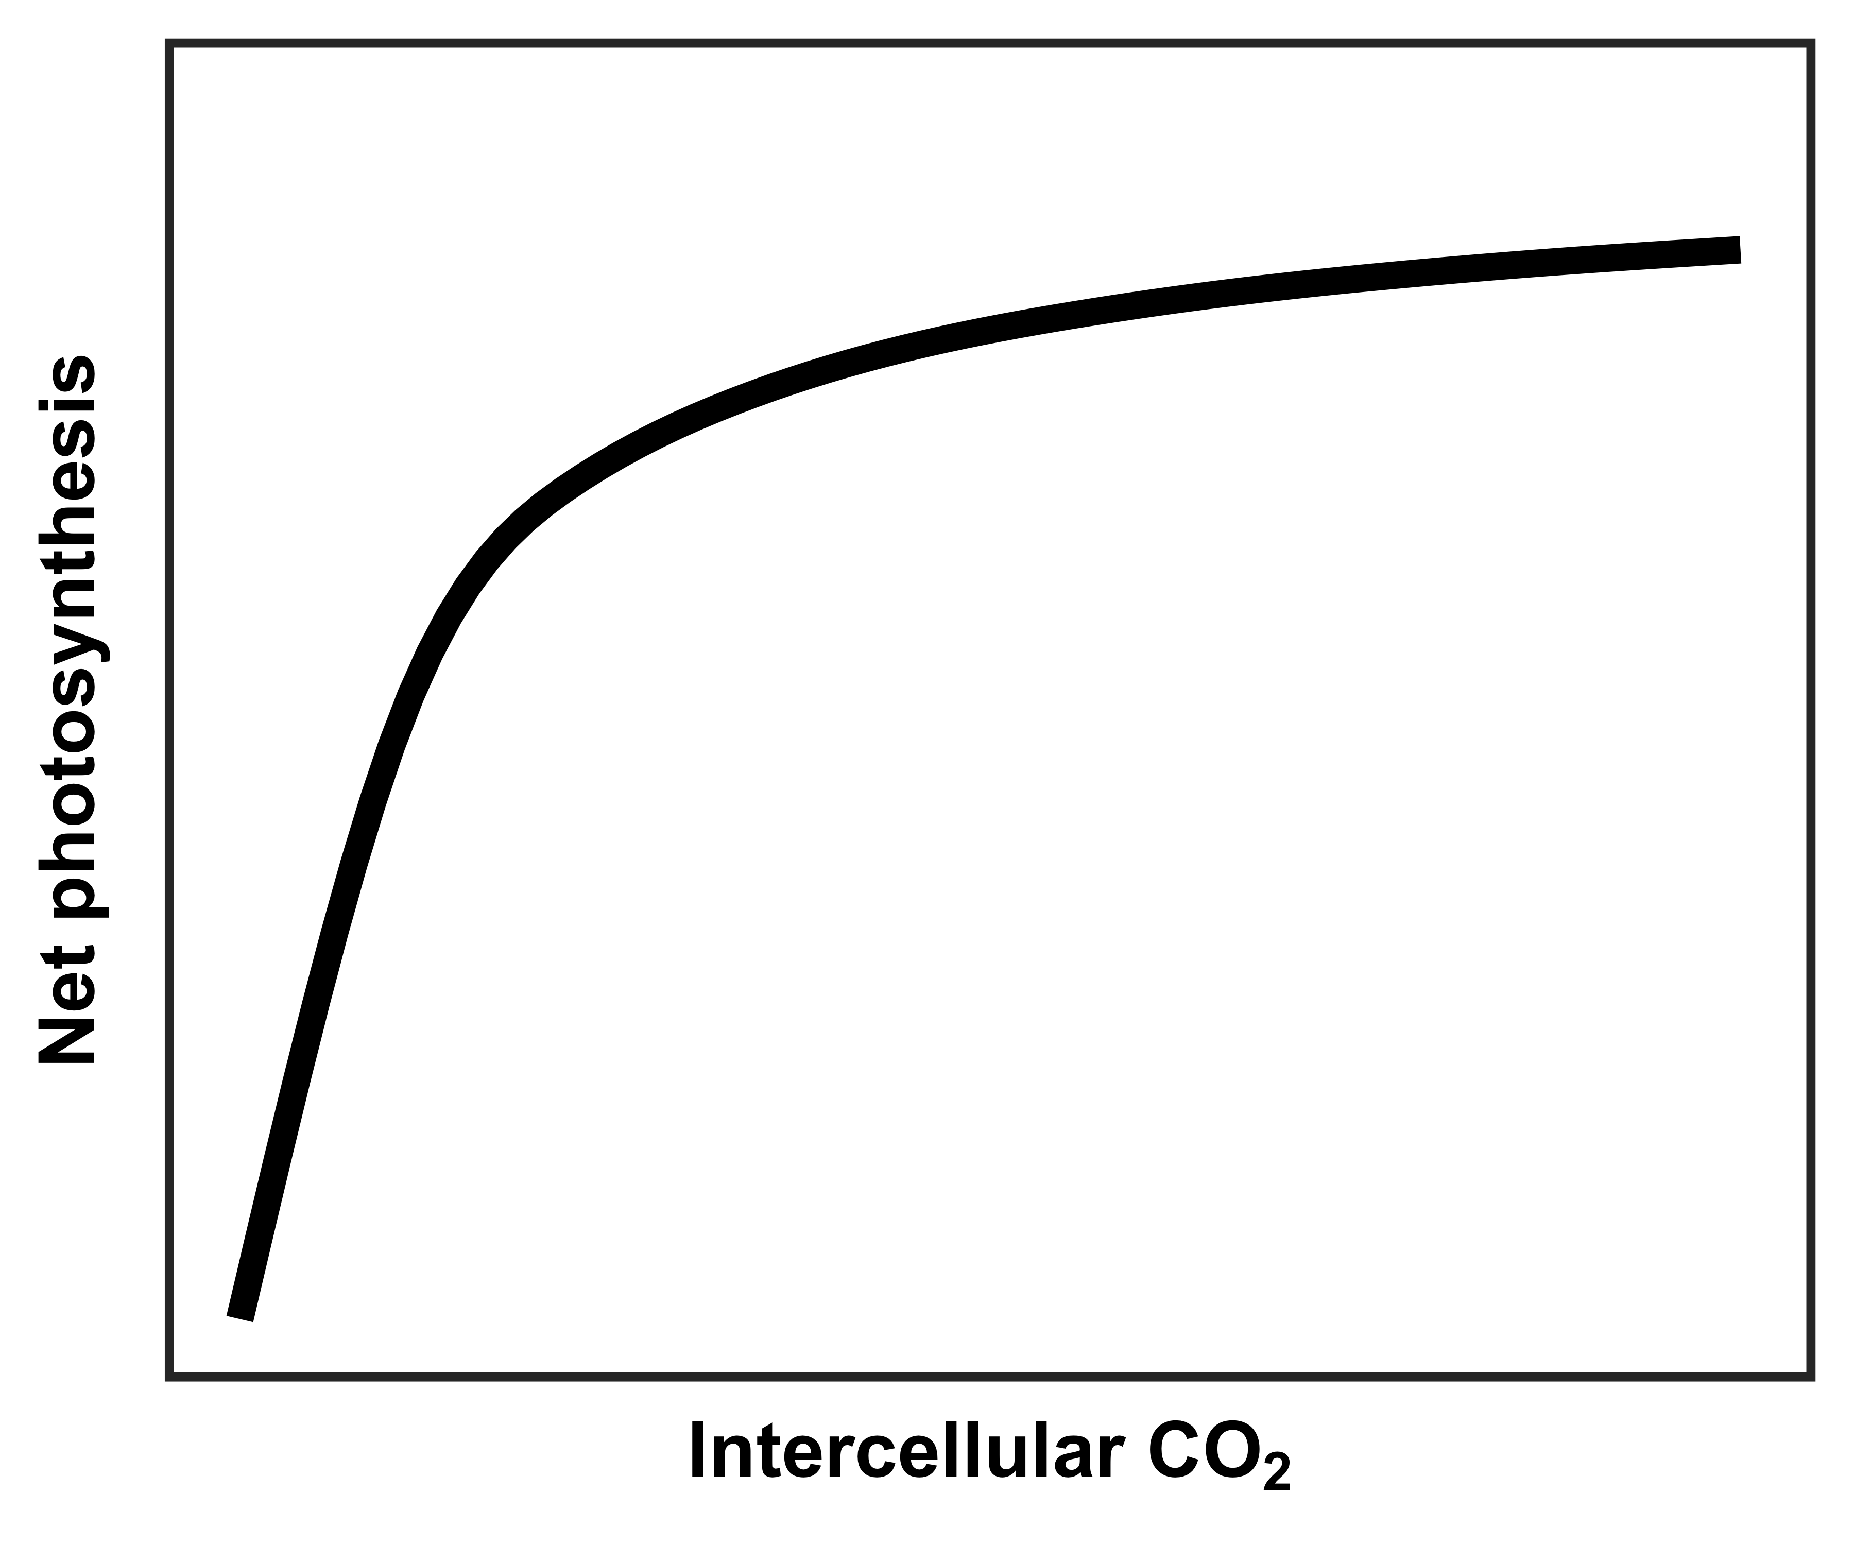
However, an alternative hypothesis suggests that plant demand to build and maintain photosynthetic enzymes drives the leaf response to CO₂
Figure adapted from Moore et al. (1999) PC&E

Slide 9
However, an alternative hypothesis suggests that plant demand to build and maintain photosynthetic enzymes drives the leaf response to CO₂
RuBP-limited photosynthesis
(A_{j})
Rubisco-limited photosynthesis
(A_{c})
net photosynthesis
at ambient CO₂
A_{c} = A_{j}
Figure adapted from Moore et al. (1999) PC&E

Slide 10
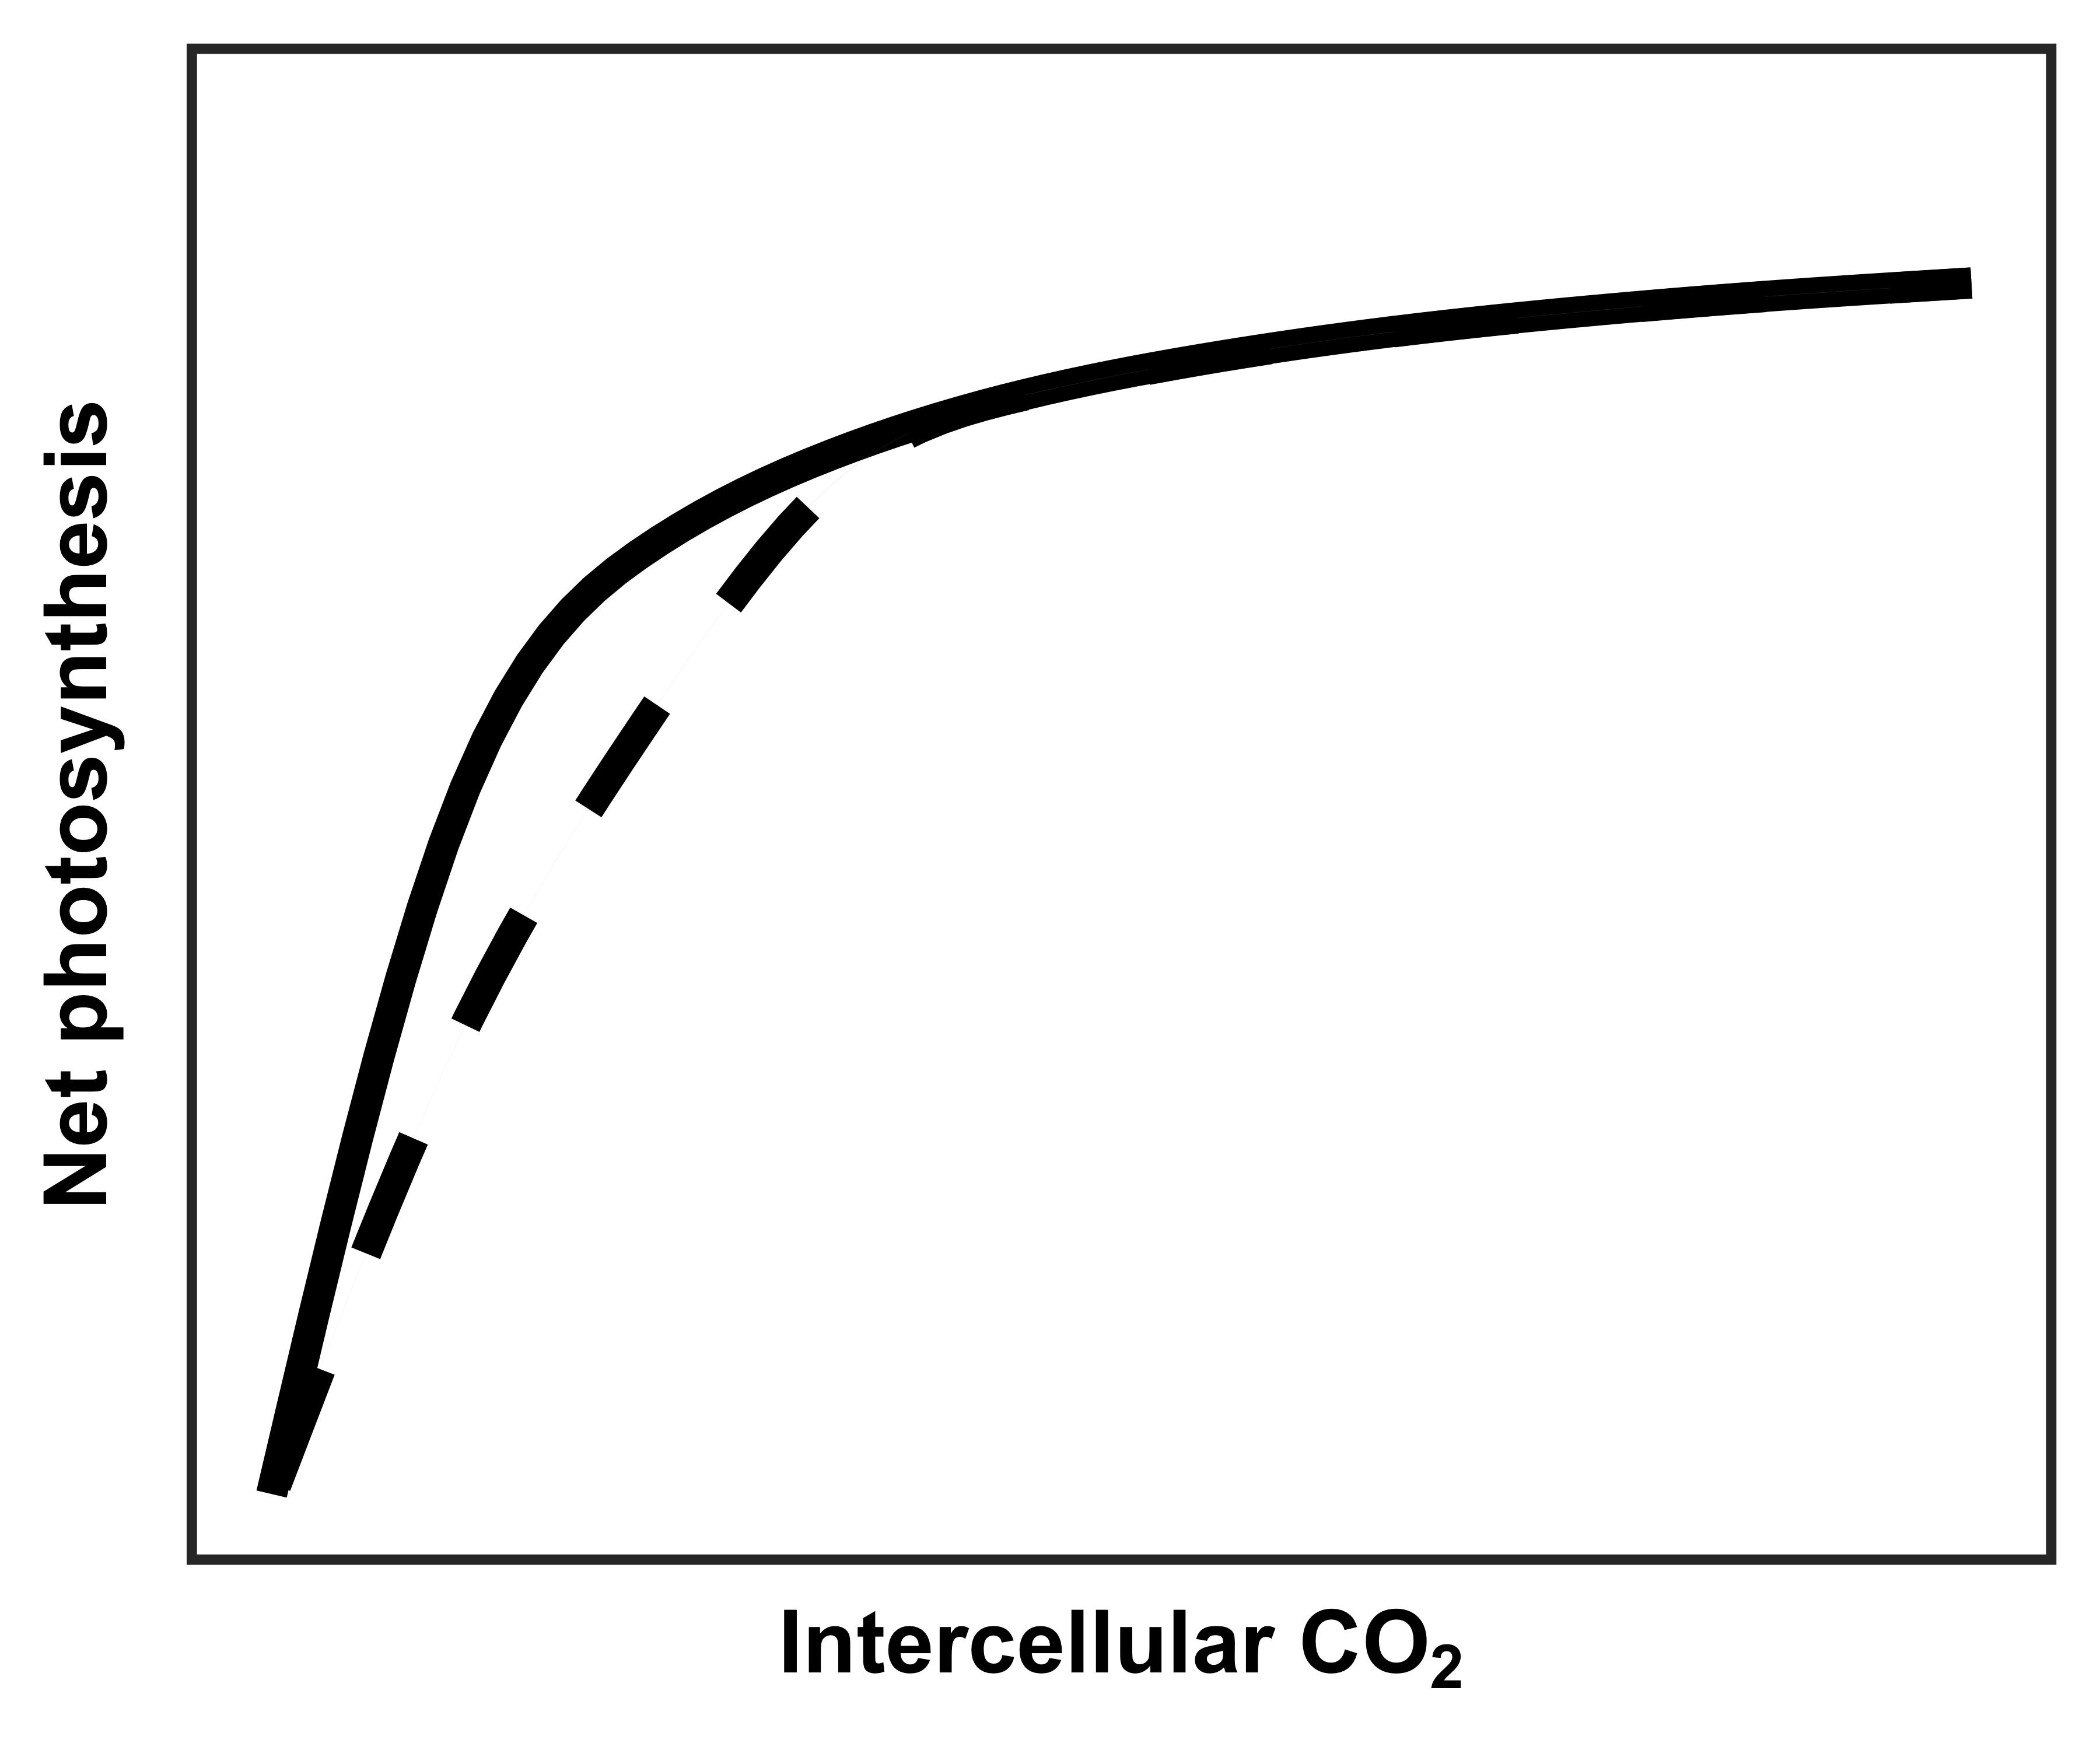
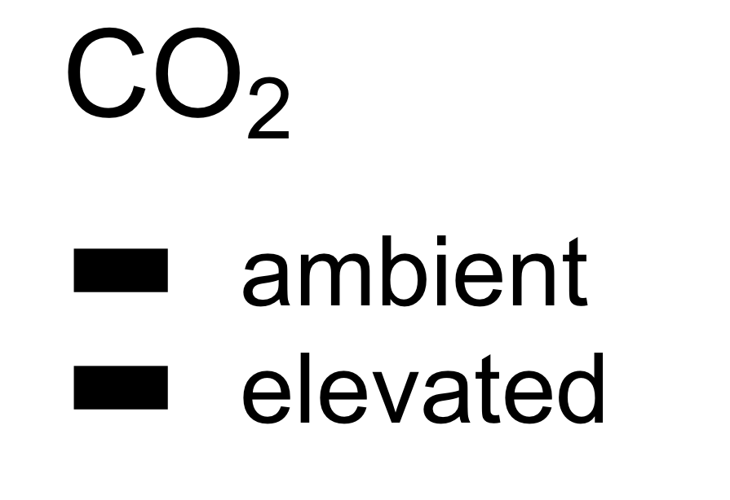
However, an alternative hypothesis suggests that plant demand to build and maintain photosynthetic enzymes drives the leaf response to CO₂
RuBP-limited photosynthesis
(A_{j})
Rubisco-limited photosynthesis
(A_{c})
net photosynthesis
at ambient CO₂
A_{c} = A_{j}
net photosynthesis
at elevated CO₂
Figure adapted from Moore et al. (1999) PC&E

Slide 11
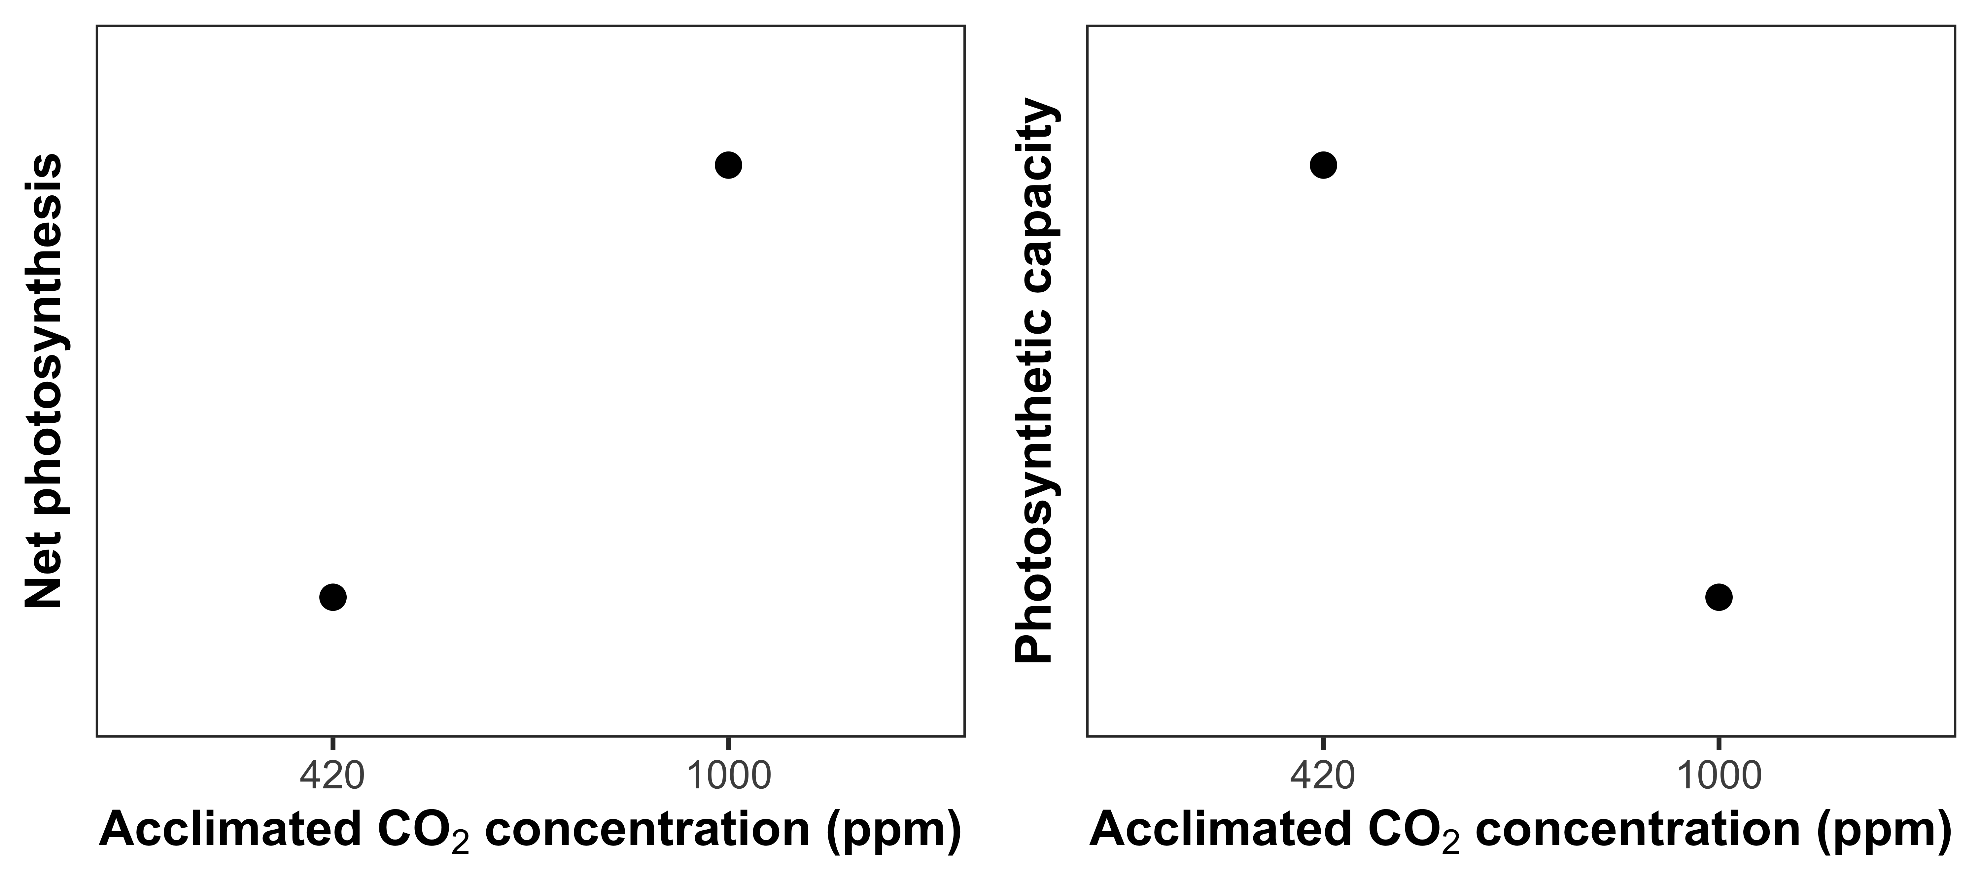
Optimal resource investment to photosynthetic enzymes increases leaf photosynthesis at lower nutrient use
Reduced photosynthetic capacity
Increased net photosynthesis
rate
Notes:
As another example to illustrate this…

Slide 12
Optimal resource investment to photosynthetic enzymes increases leaf photosynthesis at lower nutrient use
Reduced leaf
nitrogen content
Leaf nitrogen content
Increased net photosynthesis
rate
Notes:
As another example to illustrate this…

Slide 13
Study Question
How does soil nitrogen availability modify leaf and whole plant responses to CO₂?

Slide 14
Nitrogen limitation
hypothesis
eCO₂
Photosynthetic capacity
Soil N supply
Whole-plant growth
= net positive effect
= net negative effect
= null effect

Slide 15
Nitrogen limitation
hypothesis
Optimality
hypothesis
eCO₂
Photosynthetic capacity
eCO₂
Photosynthetic capacity
Soil N supply
Whole-plant growth
Soil N supply
Whole-plant growth
= net positive effect
= net negative effect
= null effect

Slide 16
Experiment setup
Acquisition strategy
Soil N treatments
0 ppm N
+ BNF
35 ppm N
- BNF
70 ppm N
105 ppm N
CO₂ treatments
140 ppm N
210 ppm N
ambient (420 ppm)
280 ppm N
elevated (1000 ppm)
350 ppm N
630 ppm N
Perkowski et al. (in prep)

Slide 17
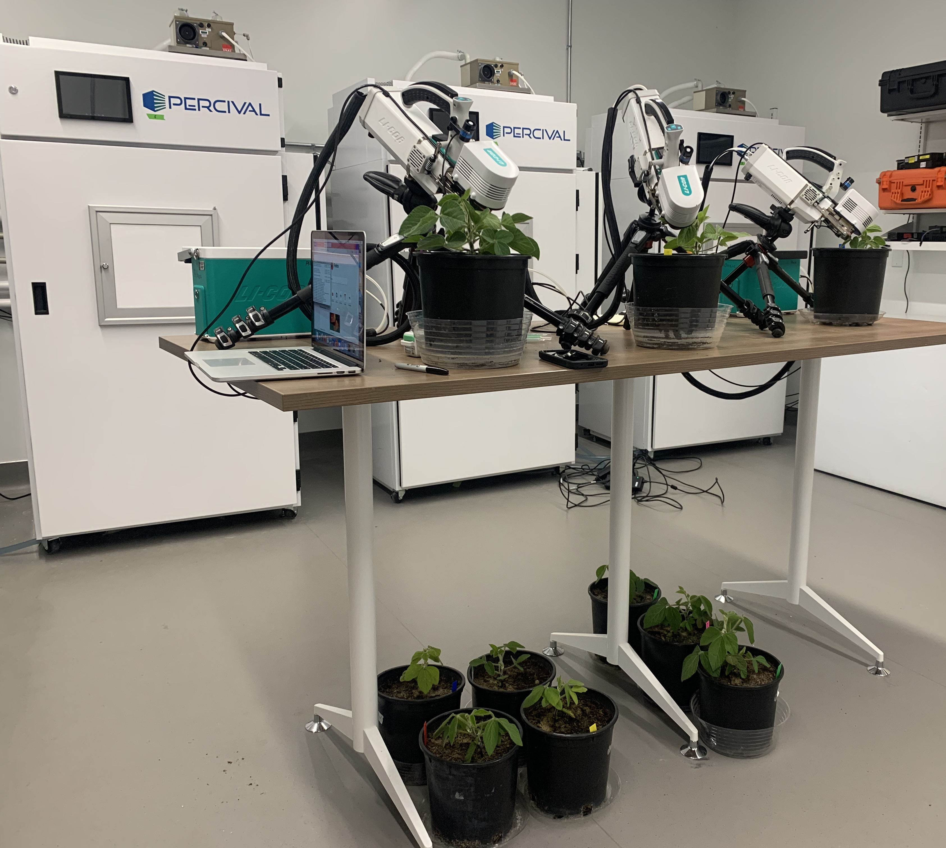
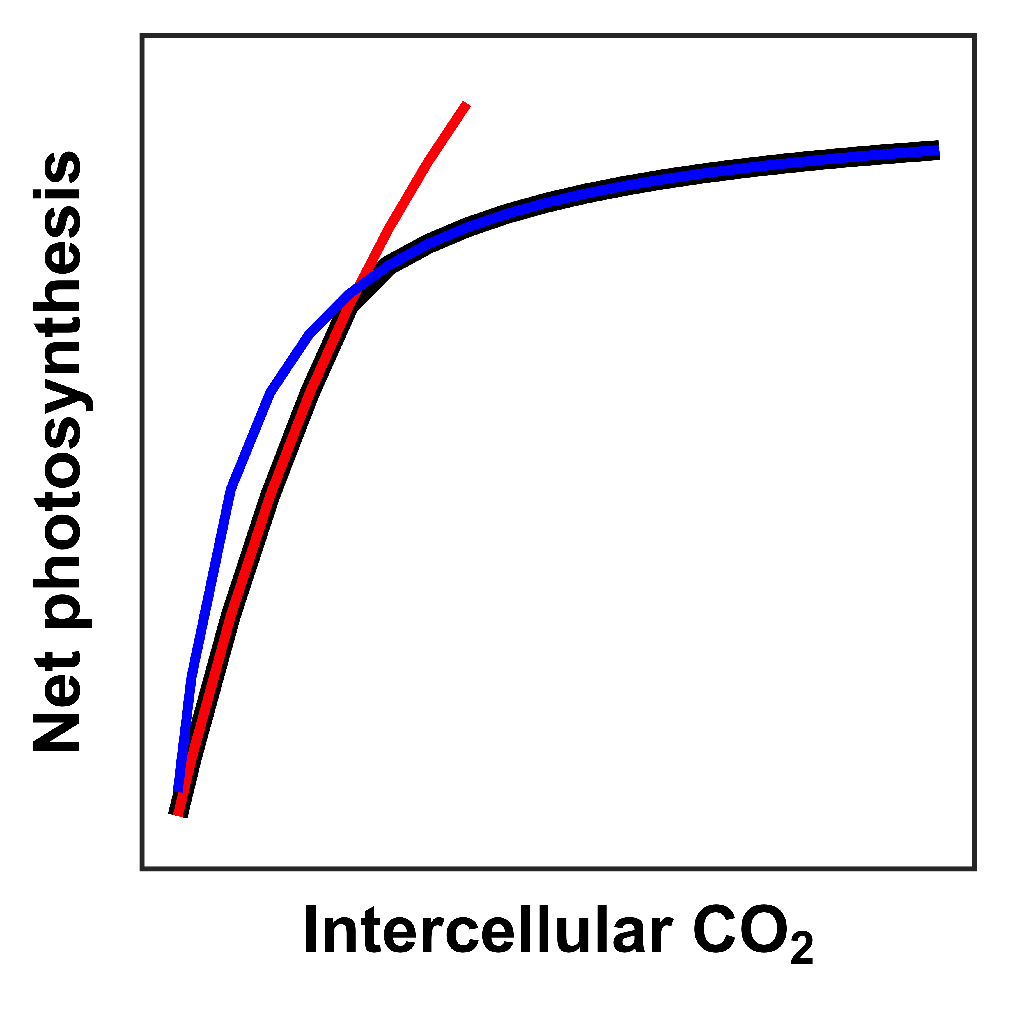
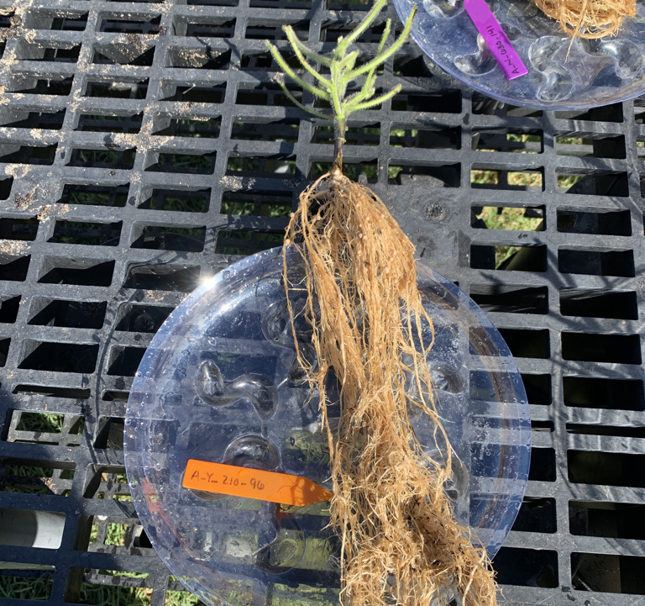
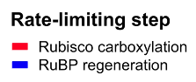
Measurements
Leaf trait
Whole plant trait
Leaf biochemistry
V_{cmax25}
J_{max25}
J_{max25}:V_{cmax25}
Total biomass
Perkowski et al. (in prep)

Slide 18
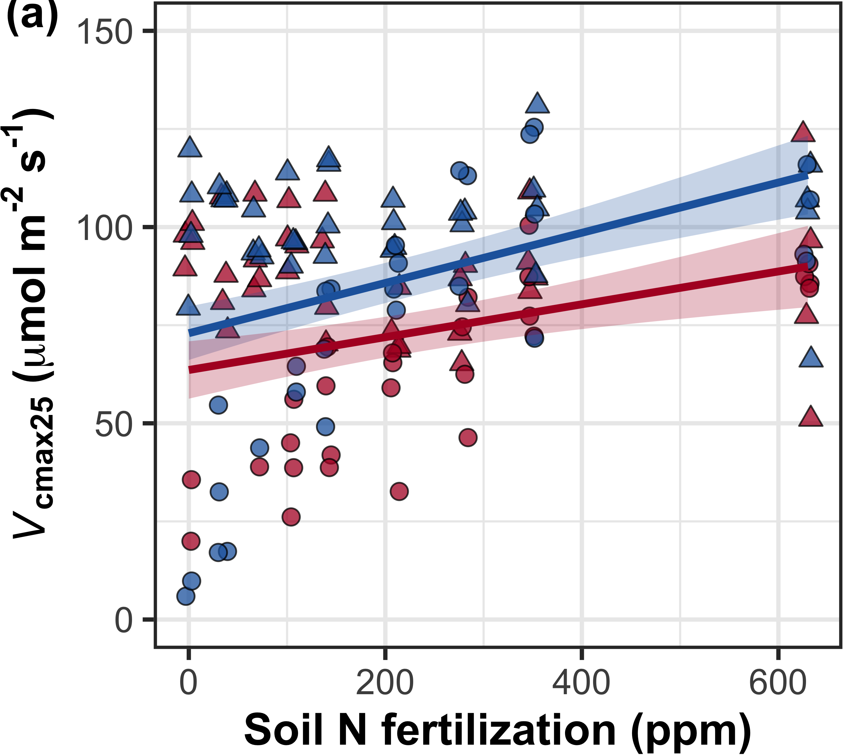
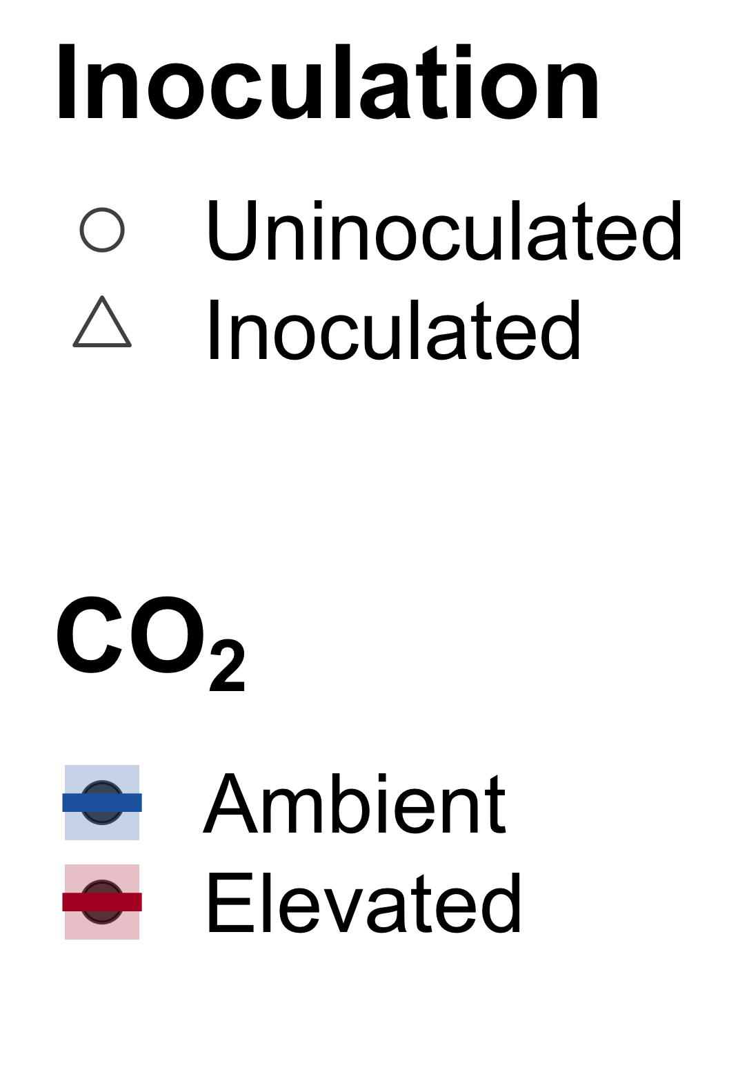
Increasing fertilization did not modify the reduction in photosynthetic capacity under elevated CO₂
CO₂: | p<0.001
Fertilization (N): | p<0.001
Inoculation (I): | p<0.001
CO₂*N interaction: | NS
CO₂*I interaction: | NS
N*I interaction: | p<0.001
Notes:
Elevated CO2 reduced leaf biochemical process rates
Soil nitrogen fertilization generally increased leaf biochemical process rates, but the slope of this relationship was similar between both CO2 treatments
Indicates that the reduction in photosynthetic capacity under elevated CO2 was independent of fertilization

Slide 19
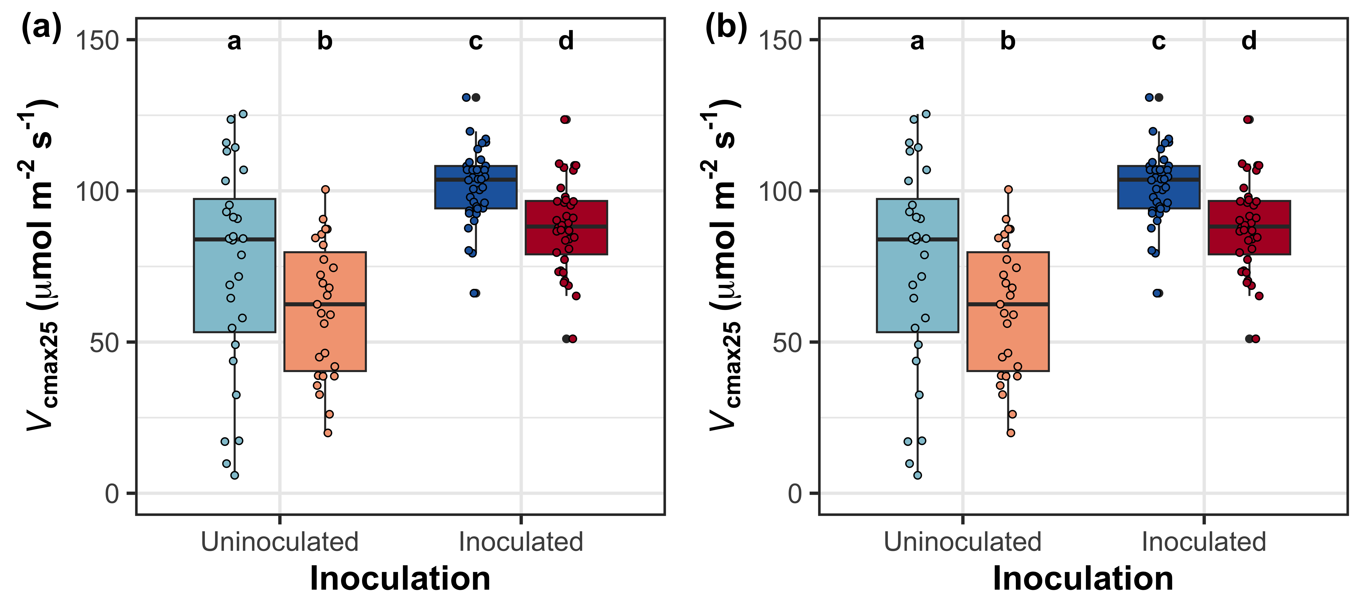
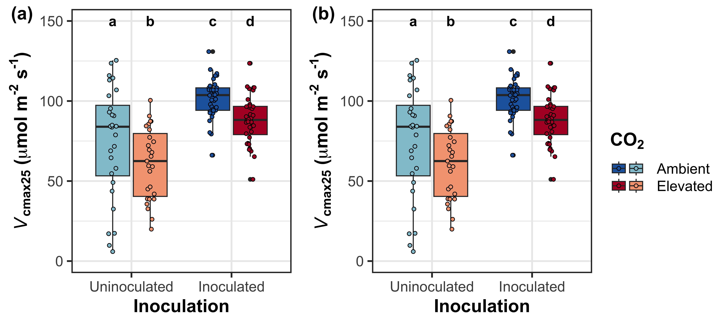
Inoculation also did not modify the reduction in photosynthetic capacity under elevated CO₂
CO₂: | p<0.001
Fertilization (N): | p<0.001
Inoculation (I): | p<0.001
CO₂*N interaction: | NS
CO₂*I interaction: | NS
N*I interaction: | p<0.001
Notes:
Elevated CO2 reduced leaf biochemical process rates
Soil nitrogen fertilization generally increased leaf biochemical process rates, but the slope of this relationship was similar between both CO2 treatments
Indicates that the reduction in photosynthetic capacity under elevated CO2 was independent of fertilization

Slide 20
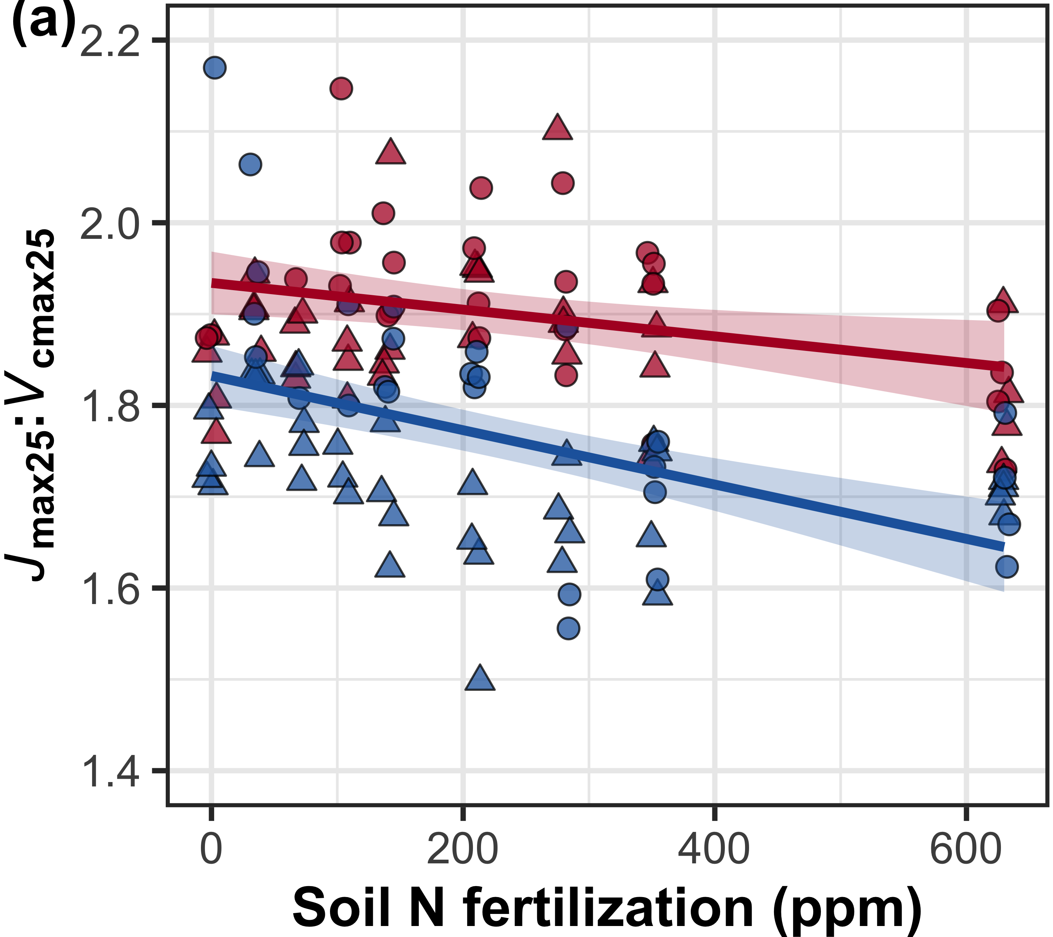
Elevated CO₂ decreased V_{cmax25} more strongly than J_{max25} independent of fertilization and inoculation treatment
CO₂: | p<0.001
Fertilization (N): | p<0.001
Inoculation (I): | p<0.001
CO₂*N interaction: | NS
CO₂*I interaction: | NS
Notes:
Optimal resource investment = stronger downregulation in Vcmax than Jmax

Slide 21
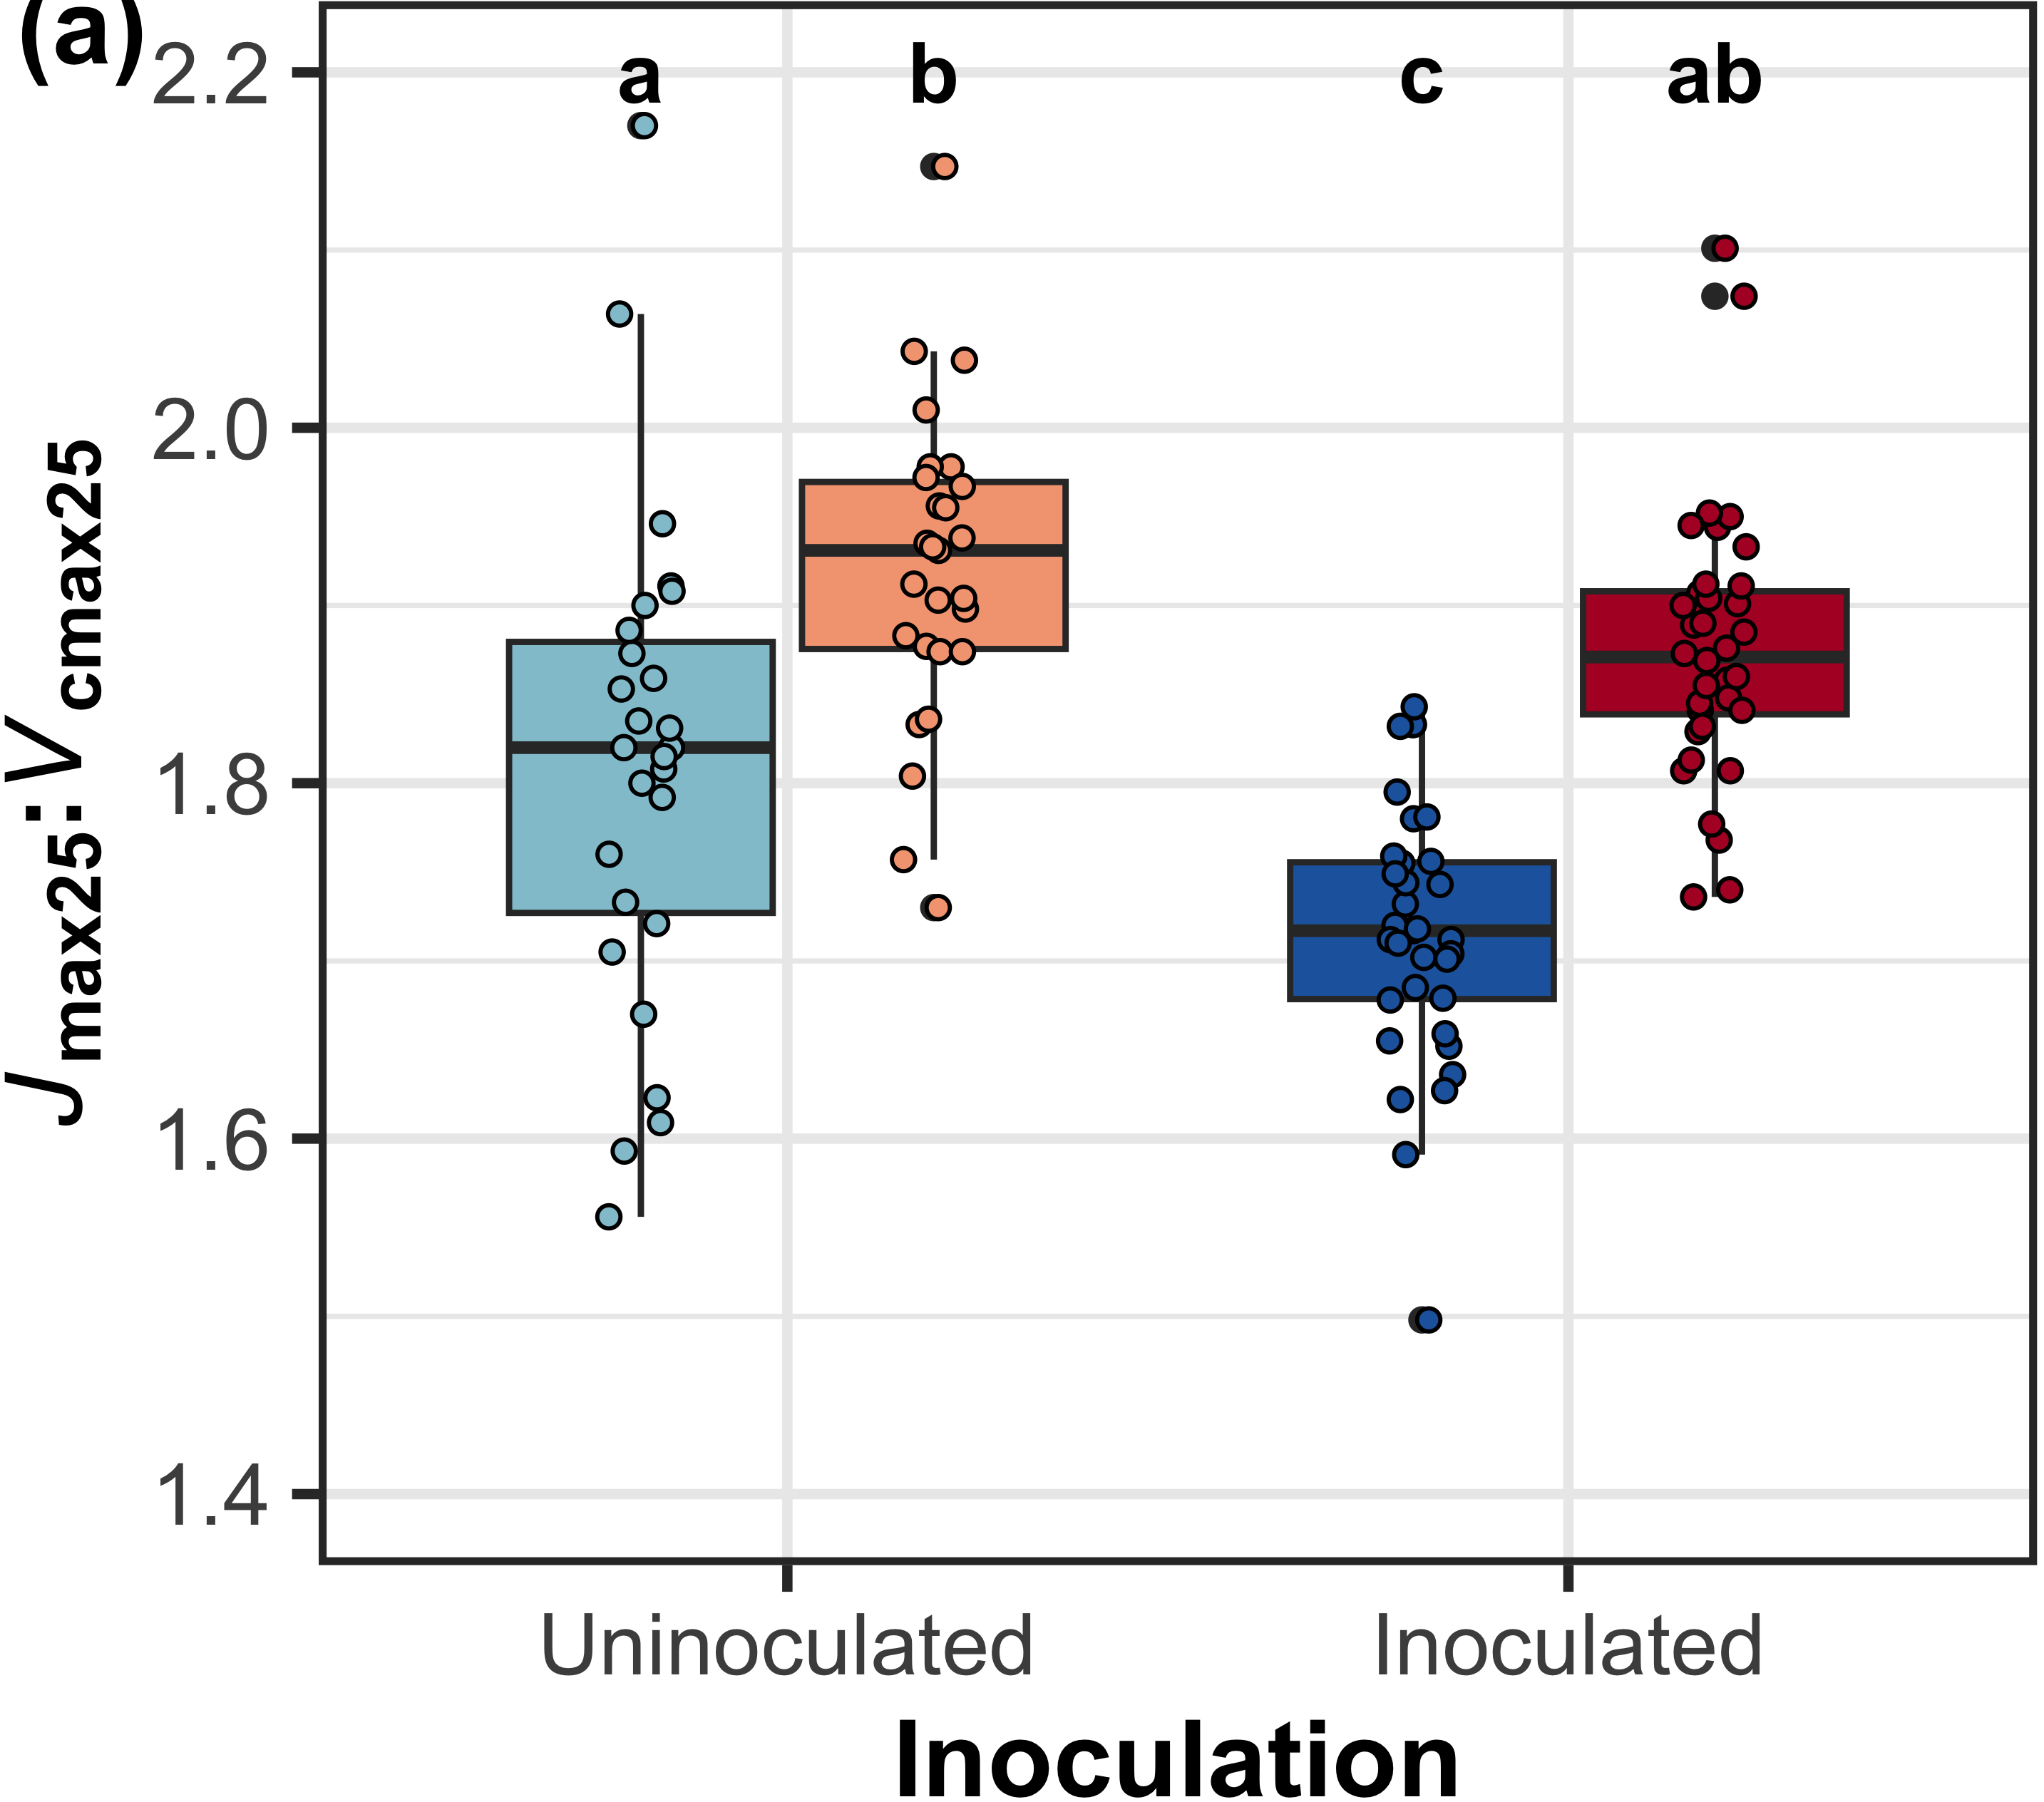
Elevated CO₂ decreased V_{cmax25} more strongly than J_{max25} independent of fertilization and inoculation treatment
CO₂: | p<0.001
Fertilization (N): | p<0.001
Inoculation (I): | p<0.001
CO₂*N interaction: | NS
CO₂*I interaction: | NS
Notes:
Optimal resource investment = stronger downregulation in Vcmax than Jmax

Slide 22
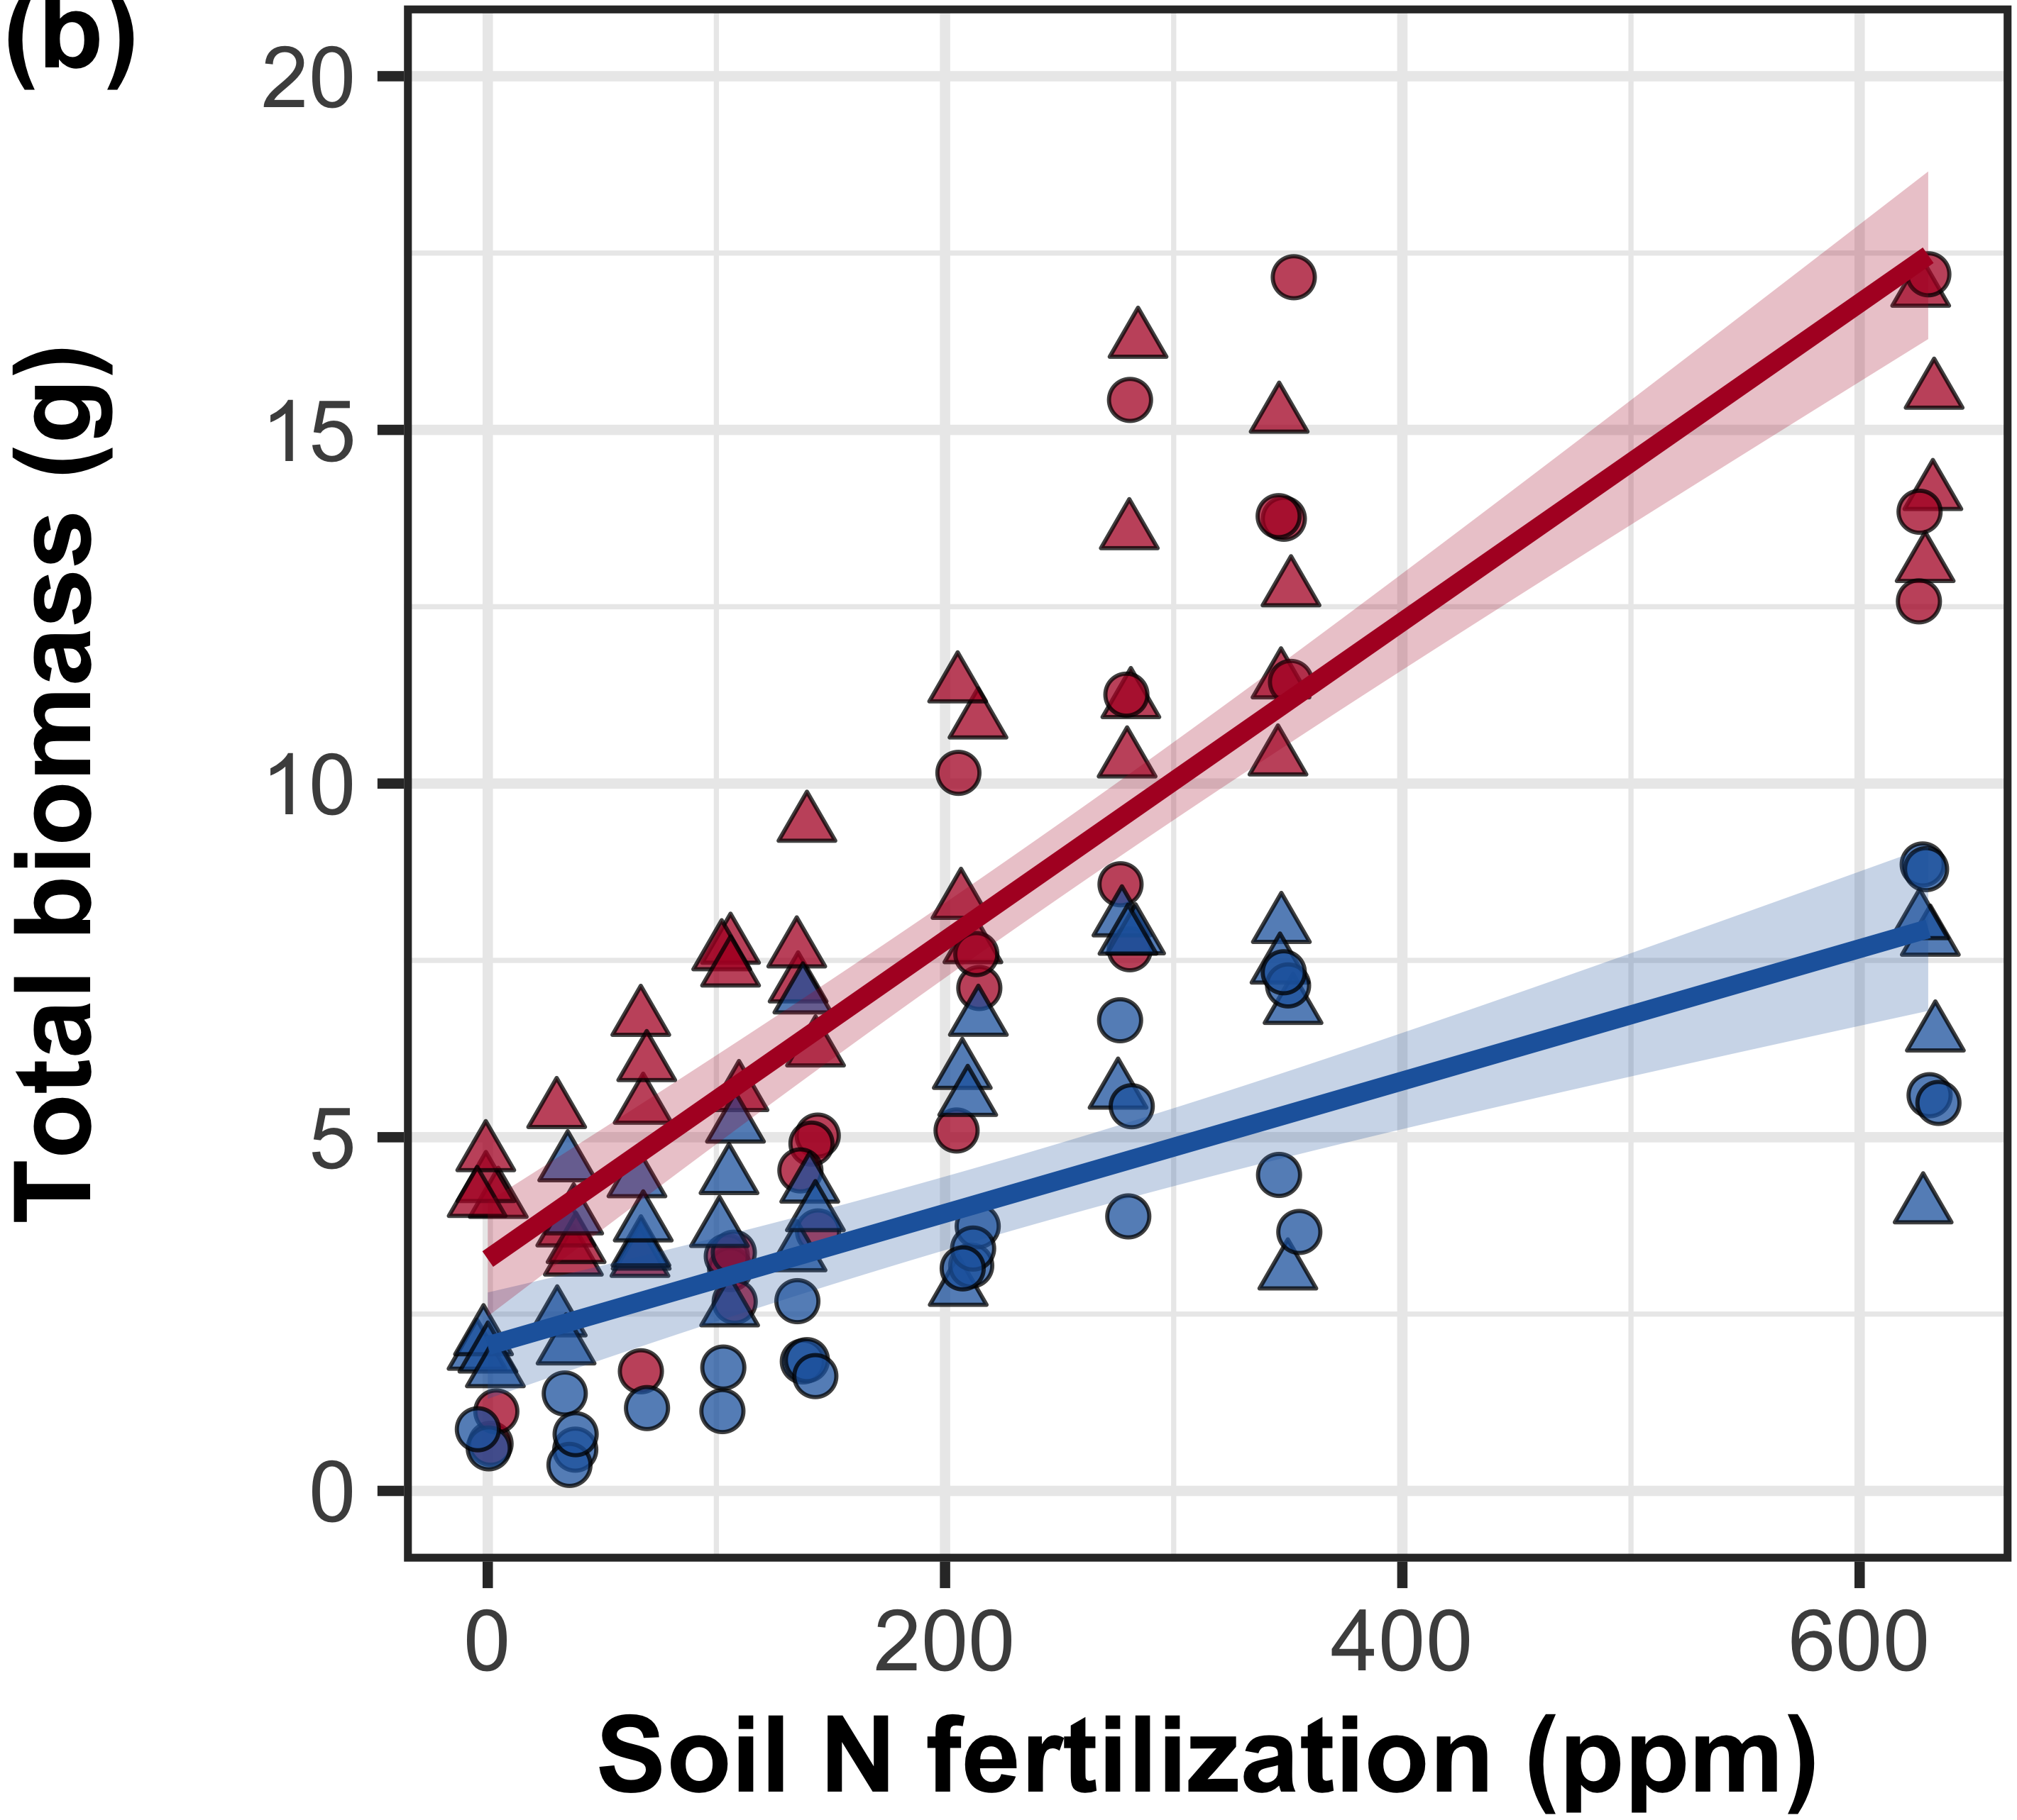
Increasing fertilization increased the positive effect of elevated CO₂ on whole-plant growth
CO₂: | p<0.001
Fertilization (N): | p<0.001
Inoculation (I): | p<0.001
CO₂*N interaction: | p<0.001
CO₂*I interaction: | NS
Perkowski et al. (in prep)
Notes:
Despite reductions in photosynthetic capacity and leaf nitrogen allocation at the leaf level, I observe strong stimulations in whole plant growth under elevated CO2

Slide 23
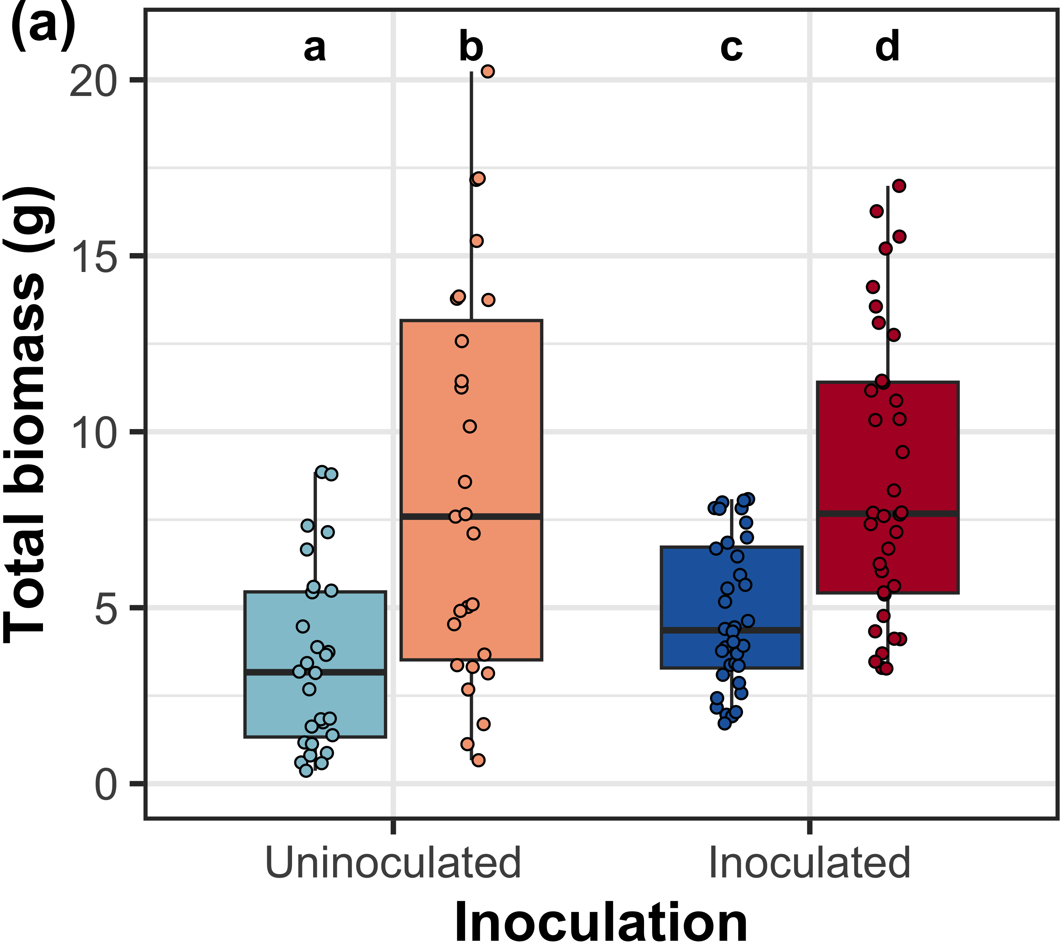
Inoculation did not modify the positive effect of eCO₂ on total biomass
CO₂: | p<0.001
Fertilization (N): | p<0.001
Inoculation (I): | p<0.001
CO₂*N interaction: | p<0.001
CO₂*I interaction: | NS

Slide 24
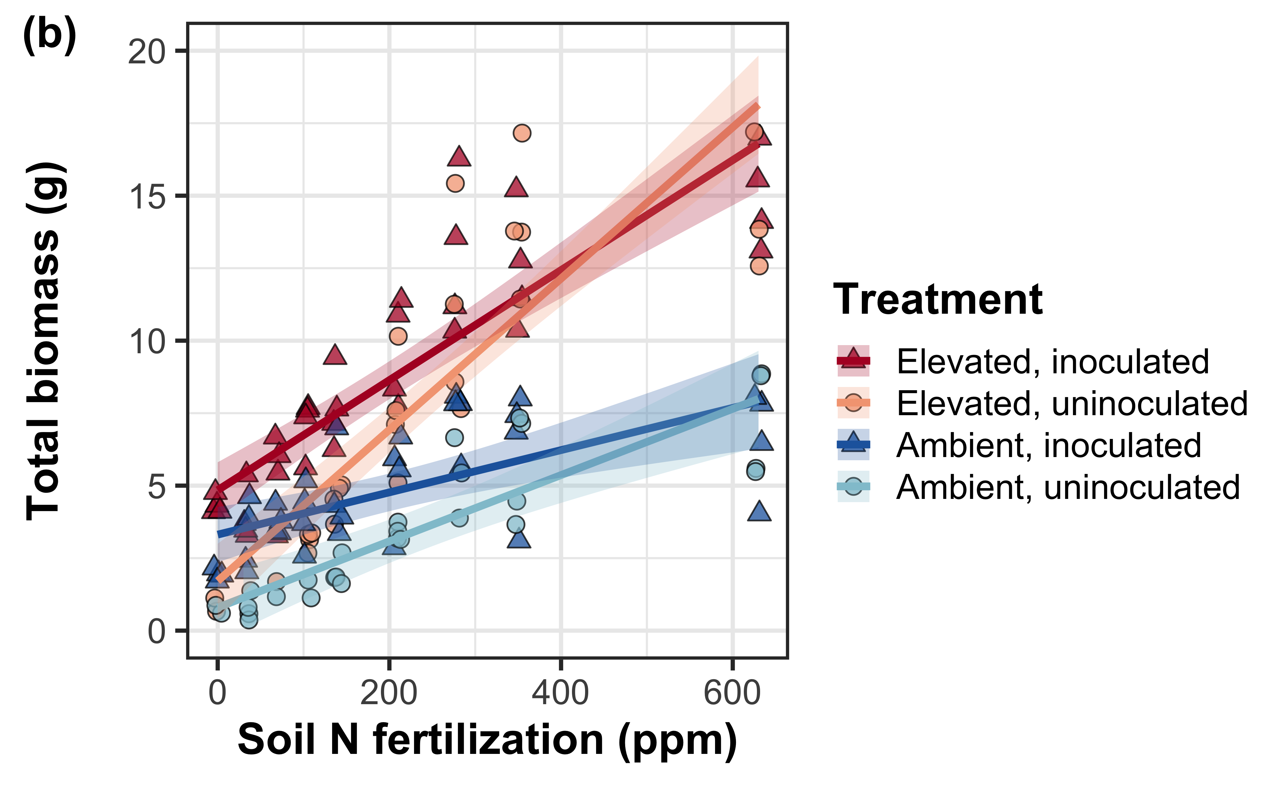
However, inoculated plants had greater total biomass under low fertilization
CO₂: | p<0.001
Fertilization (N): | p<0.001
Inoculation (I): | p<0.001
CO₂*N interaction: | p<0.001
CO₂*I interaction: | NS
N*I interaction: | p<0.001
Perkowski et al. (in prep)
Notes:
Despite reductions in photosynthetic capacity and leaf nitrogen allocation at the leaf level, I observe strong stimulations in whole plant growth under elevated CO2

Slide 25
Conclusions
N demand and supply control plant responses to eCO₂ at different scales
N supply → whole-plant response to eCO₂
N demand → leaf response to eCO₂
Leaf and whole plant responses to fertilization are dependent on acquisition strategy
eCO₂
Photosynthetic capacity
Soil N supply
Whole-plant growth

Slide 26
Conclusions
N demand and supply control plant responses to eCO₂ at different scales
N supply → whole-plant response to eCO₂
N demand → leaf response to eCO₂
Plant responses to fertilization are dependent on acquisition strategy
eCO₂
Photosynthetic capacity
Soil N supply
Whole-plant growth
Acquisition strategy

Slide 27
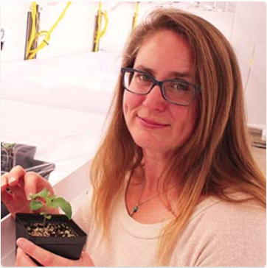





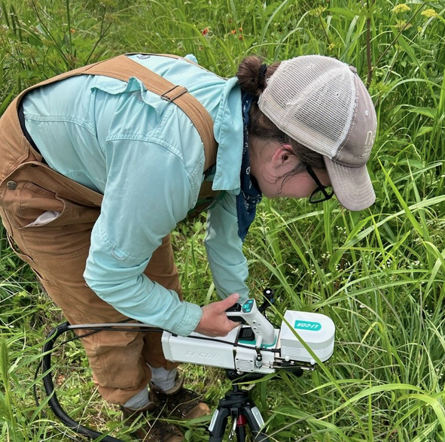




Acknowledgements
Mylea Lovell
TTU Phytotron manager
Alissar Cheaib
Smith Lab Post-doc
Brad Posch
Former Smith Lab Post-doc
Kelly Carroll
Smith Lab Manager
Eve Gray
Smith Lab MS student
Monika Kelly
Smith Lab MS student
Isa Beltran
Smith Lab MS student
Snehanjana Chatterjee
Smith Lab PhD student
Hannah German
Smith Lab UG student

Slide 28
Thank you!

Slide 29
Extra slides

Slide 30
Soil N fertilization only influences leaf biochemical process rates in uninoculated pots
Perkowski et al. (in prep)

Slide 31
Inoculation reduced the negative effect of increasing fertilization on costs to acquire nitrogen
Perkowski et al. (in prep)

Slide 32
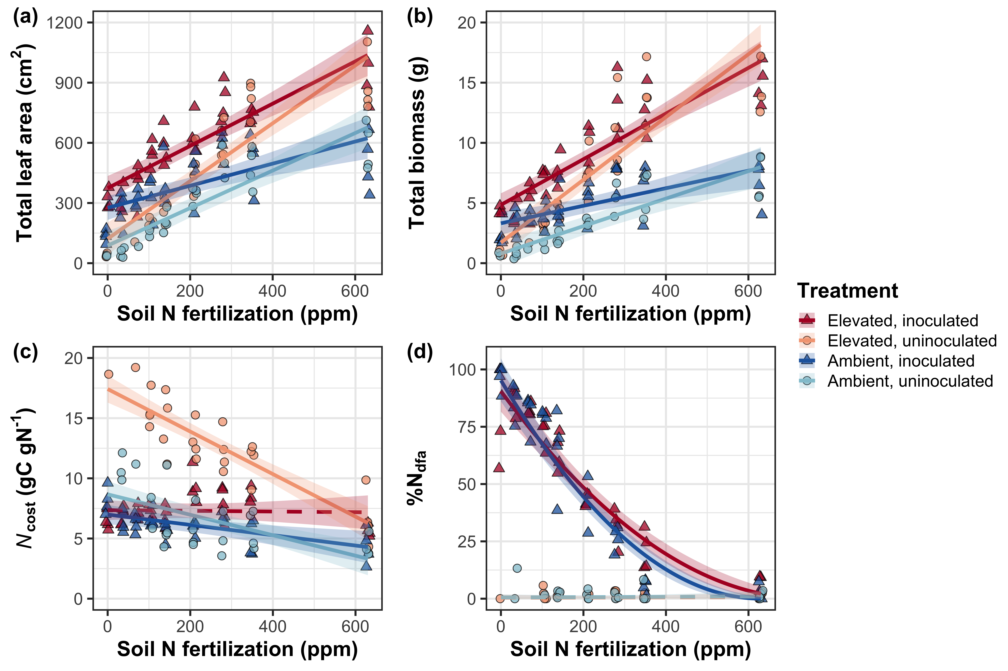
Plants reduce investment in nitrogen fixation with increasing fertilization
Perkowski et al. (in prep)

